Slide 1
Evaluating Information
Genome 575: Fundamentals of Biomedical Instrumentation
Brian Beliveau

Slide 2
Recap from last time
Information can be discrete or continuous
Sampling rate is a very important consideration
Information can be quantized (bits)
Information entropy describes the “expected surprisal”

Slide 3
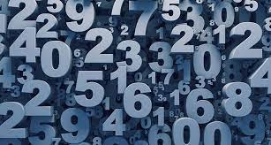
The guessing games
H(X=1–100) = - sum(1-100)[1/100 * log₂(1/100)] = 6.64 bits
I(X=50, match) = -log(1/100) = 6.64 bits
I(X=50, lower) = - log₂(49/100) = 1.03 bits
I(X=50, higher) = - log₂(50/100) = 1 bit
I(X=33, match) = -log(1/100) = 6.64 bits
I(X=33, lower) = - log2(32/100) = 1.64 bits
I(X=33, higher) = - log2(67/100) = 0.58 bits
https://www.sciencenews.org/wp-content/uploads/2018/05/050718_EC_numbers_feat.jpg

Slide 4
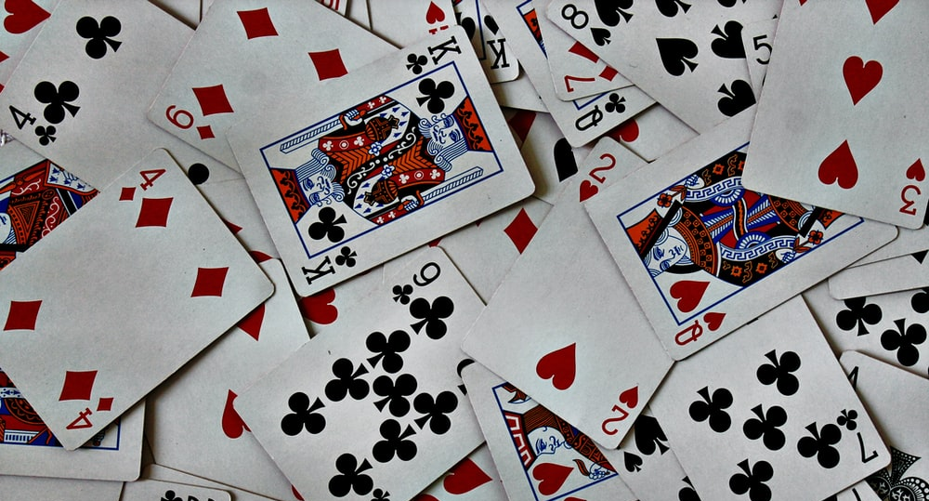
The guessing games
H(X=card) = - sum(1-52)[1/52 * log₂(1/52)] = 5.70 bits
I(X=color, match) = -log₂ (1/2) = 1 bit
I(X= color, miss) = -log₂(1/2) = 1 bit
I(X=suit, match) = -log₂(1/4) = 2 bits
I(X=suit, miss) = -log₂(3/4) = 0.42 bits
I(X=7, match) = -log₂ (1/13) = 3.7 bits
I(X=value, lower) = -log₂ (6/13) = 1.12 bits
I(X=value, higher) = -log₂ (6/13) = 1.12 bits
I(X=Jack, match) = -log₂ (1/13) = 3.7 bits
I(X=Jack, lower) = -log₂ (9/13) = 0.53 bits
I(X=Jack, higher) = -log₂ (3/13) = 2.1 bits
I(X=Y of Z, ie, exact identity, success) = -log₂(1/52) = 5.7 bits
I(X=Y of Z, ie, exact identity, failure) = -log₂(51/52) = 0.03 bits
https://images.unsplash.com/photo-1541278107931-e006523892df?ixlib=rb-1.2.1&ixid=MnwxMjA3fDB8MHxzZWFyY2h8MXx8Y2FyZHN8ZW58MHx8MHx8&w=1000&q=80

Slide 5
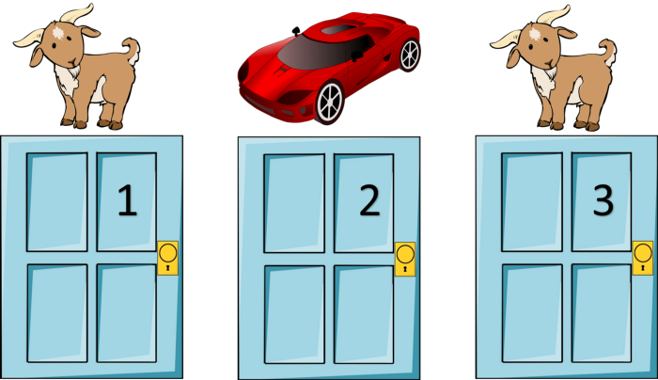
Another (familiar?) game…
https://mathematicalmysteries.org/the-monty-hall-problem/

Slide 6
Let’s make a deal…
1/3
https://mathematicalmysteries.org/the-monty-hall-problem/

Slide 7
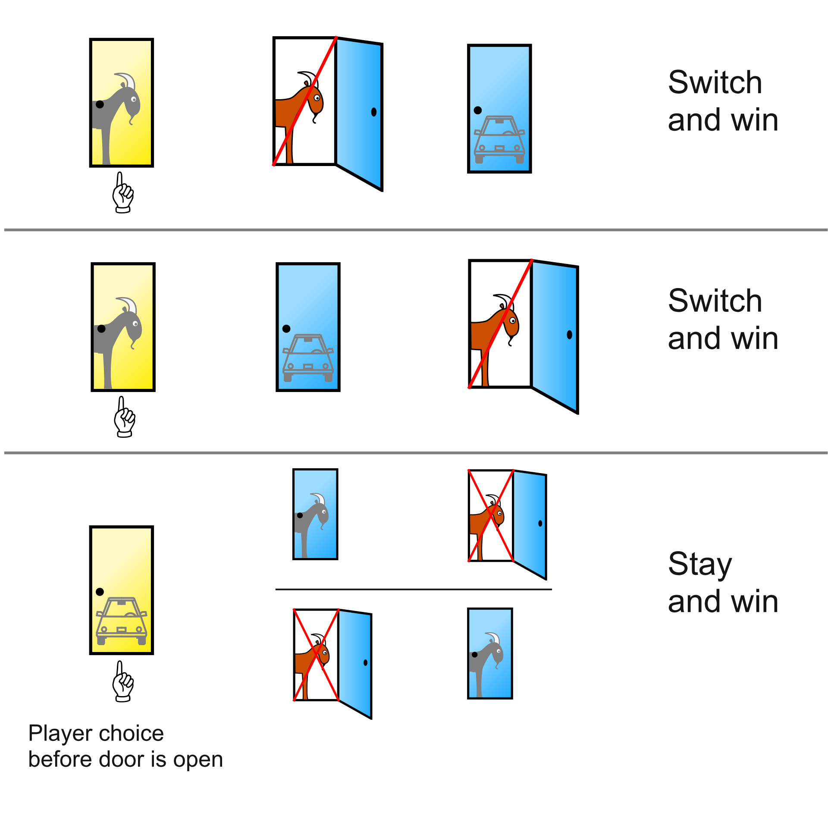
The Bayesian explanation
2/3
1/3
https://en.wikipedia.org/wiki/Monty_Hall_problem#/media/File:Monty_Hall_Problem_-_Standard_probabilities.svg

Slide 8
Information theory
H(X=1–3) = - sum(1-3)[1/3 * log₂(1/3)] = 1.58 bits
H(X=1,2 or X=1,3 or X=2,3) = - sum(1/3 * log₂(1/3) + 2/3 log₂(2/3)] = 0.918 bits
https://en.wikipedia.org/wiki/Monty_Hall_problem#/media/File:Monty_Hall_Problem_-_Standard_probabilities.svg

Slide 9
How do we evaluate information?
Class activity (10 mins): What questions should we ask about data/datasets?
Supplementary Dataset 1
https://www.tampabay.com/resizer/geVYWof5v2nP75k6cGzYunNkMRc=/1400x2500/smart/arc-anglerfish-arc2-prod-tbt.s3.amazonaws.com/public/KAE7GFWHDQI6TBKNIBWI6S7HAY.jpg

Slide 10

How do we evaluate information?
Supplementary Dataset 1
Sample size?
Statistical testing?
QC metrics?
Methods well described?
Technical replicates?
Biological replicates?
Confounding variables?
Data stratification?
Over-fitting / leakage?
Aliasing / artifacts?
Misconduct?
https://images.emojiterra.com/google/android-11/512px/1f914.png

Slide 11
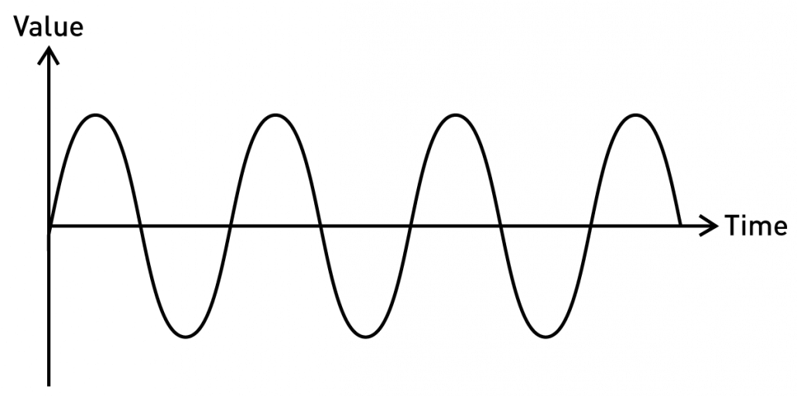
Reminder: types of information
Continuous / Analog
Fully defined. Ie, f(t) == val for any t (in some interval)
Properties such as f, wavelength, amplitude can convey information
https://blog.seeedstudio.com/wp-content/uploads/2020/06/sine-new-1030x512.png

Slide 12
Evaluating continuous information
Goodness of fit / likelihood
RMSE
https://blog.seeedstudio.com/wp-content/uploads/2020/06/sine-new-1030x512.png

Slide 13
Thresholding
Turns continuous information into binary (and discrete)
Establishes decision boundaries
https://blog.seeedstudio.com/wp-content/uploads/2020/06/sine-new-1030x512.png

Slide 14
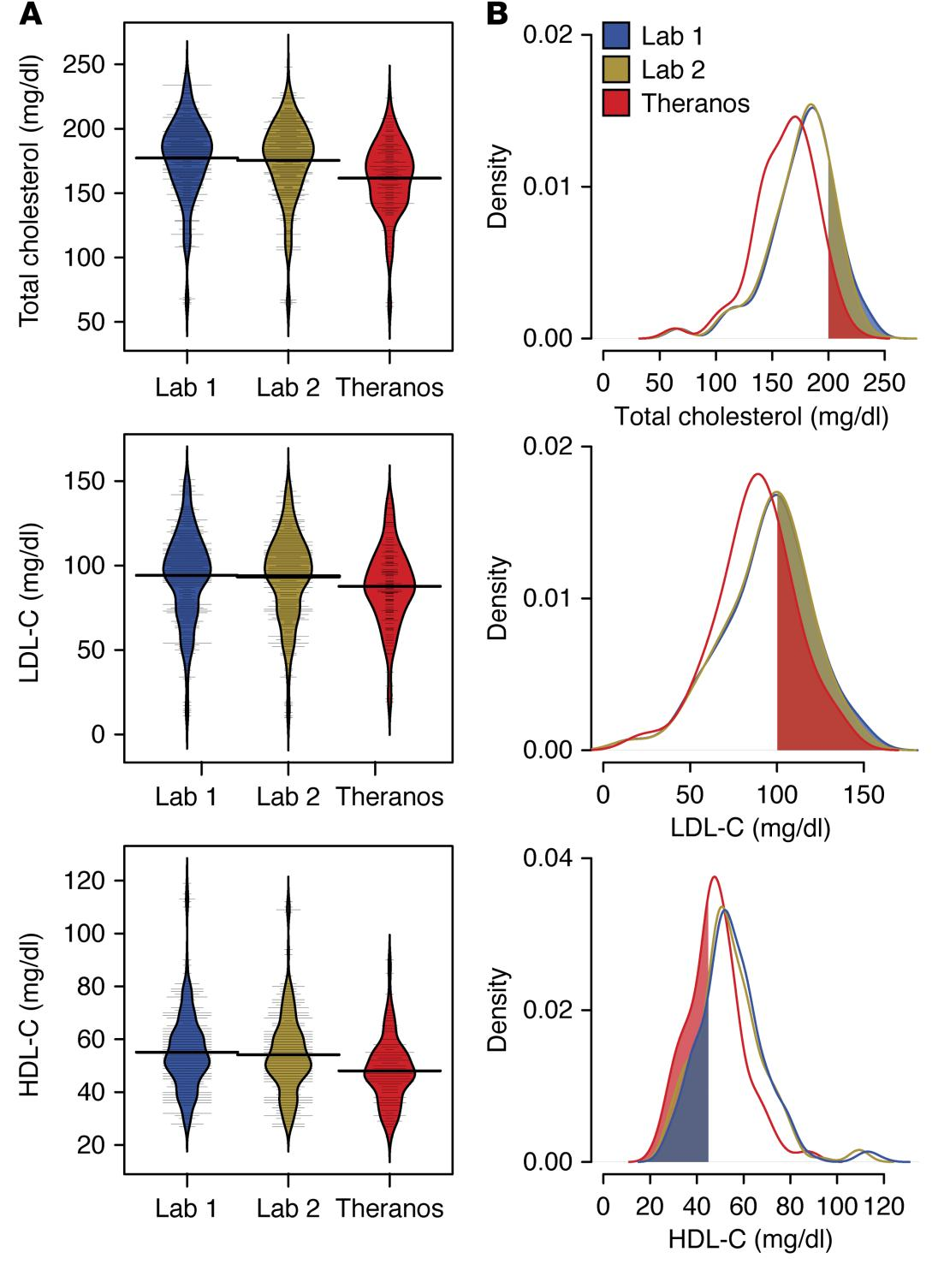
Thresholding in practice
Lab 3
Lab 3
Lab 3
Blood tests from 3 commercial testing sources
Cholesterol, LDL-C, HDL-C have defined normal ranges (upper and lower thresholds)
https://dm5migu4zj3pb.cloudfront.net/manuscripts/86000/86318/large/JCI86318.f4.jpg

Slide 15
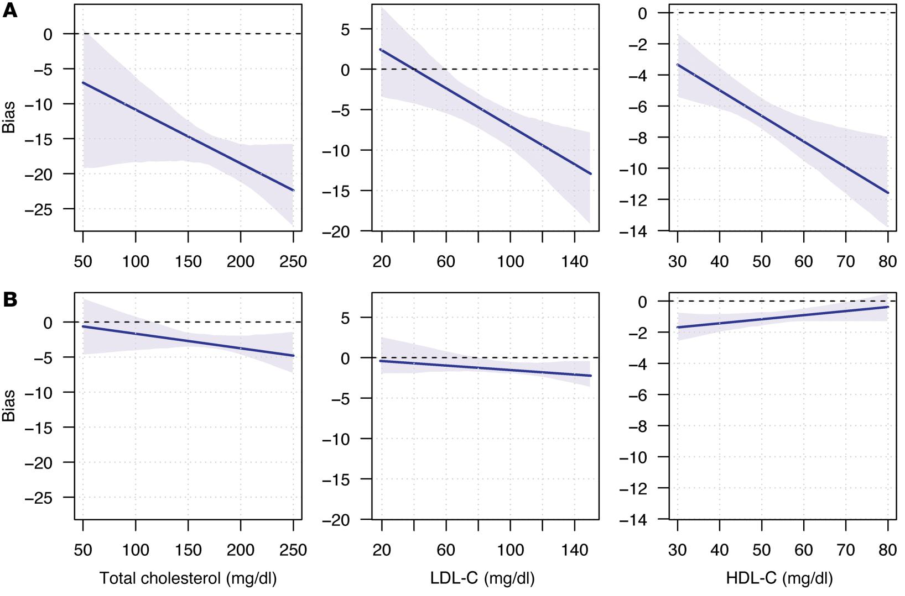
Assessing bias in measurements
I: Lab 3
J: Lab 1
I: Lab 2
J: Lab 1
Bias = discrepancy in using data source I as an estimator for data source J
https://dm5migu4zj3pb.cloudfront.net/manuscripts/86000/86318/large/JCI86318.f5.jpg

Slide 16



A tale of three labs
I: Lab 3
J: Lab 1
I: Lab 2
J: Lab 1
Lab 1
Lab 2
Lab 3
https://1000logos.net/wp-content/uploads/2021/03/Quest-Diagnostics-logo-768x502.png, https://hitconsultant.net/wp-content/uploads/2022/02/Ascension-Selects-Labcorp-to-Manage-Labs-Across-10-States.jpg, https://1000logos.net/wp-content/uploads/2020/11/Theranos-Logo-1024x640.png

Slide 17
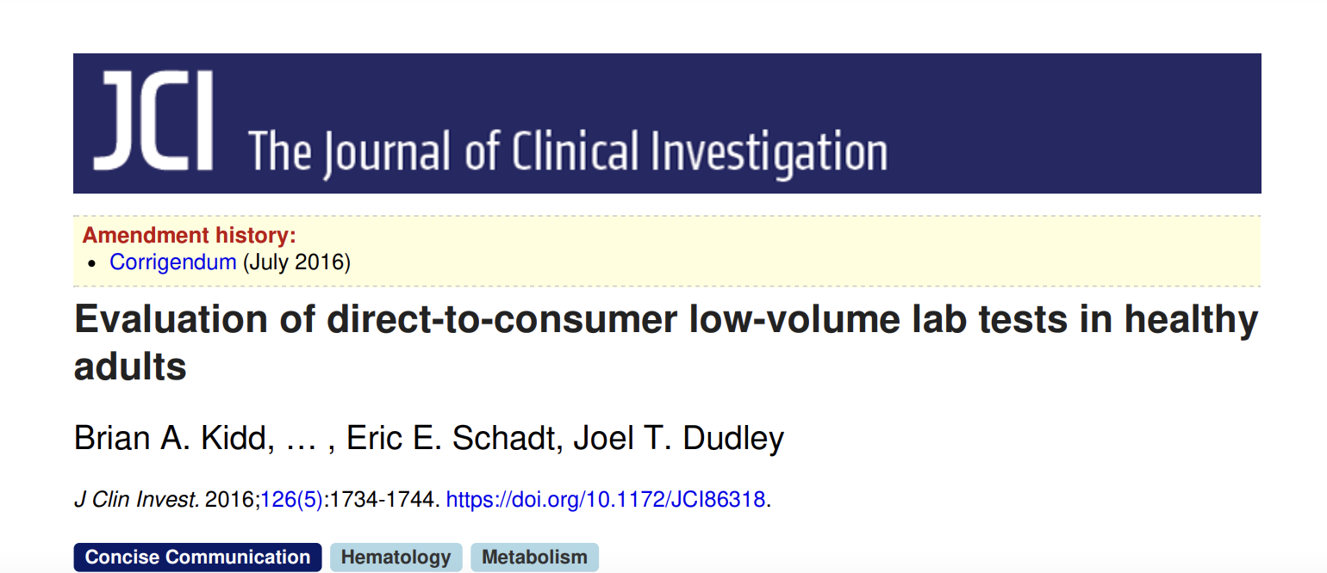
A tale of three labs
The lack of technical replicates in the Theranos data is a notable limitation in our assessment of variability. Given the large intraindividual variability for lab tests from standard clinical services, understanding the variability in low-volume testing is critical for helping physicians and patients interpret test results …
The technical details of the analytical instruments used for the lab tests were unavailable at the time of the study and remained uncertain since its completion, which means that the differences we found could arise from multiple sources…
https://www.jci.org/articles/view/86318/pdf

Slide 18
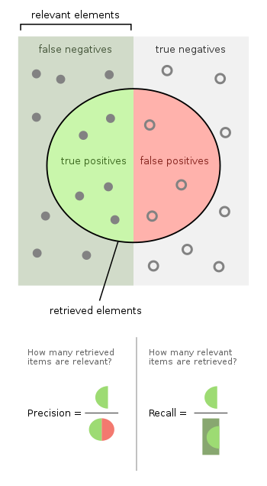
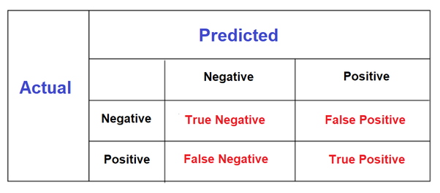
Classifying binary information
“Truth Table”
https://qph.cf2.quoracdn.net/main-qimg-d1f717f321a4ebc8e6d2c1d1cc19f9fc, https://upload.wikimedia.org/wikipedia/commons/thumb/2/26/Precisionrecall.svg/700px-Precisionrecall.svg.png

Slide 19

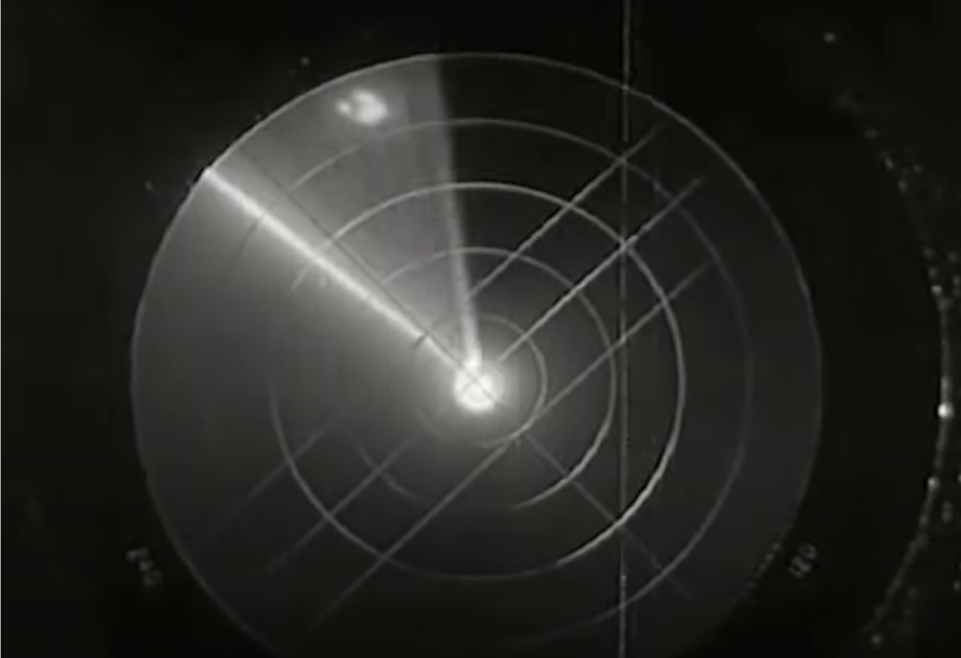
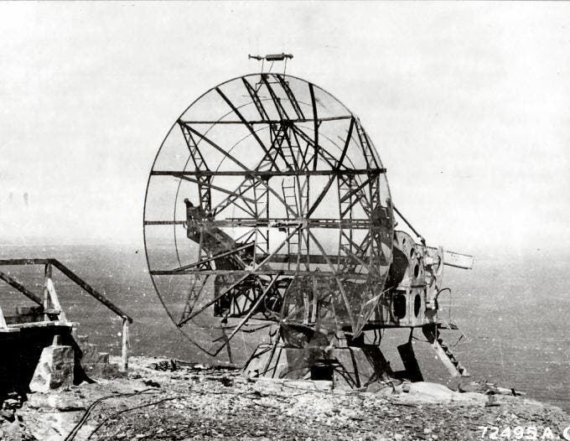

Classifying binary information
Or
https://www.youtube.com/watch?v=73pU2lRHefQ, https://worldwarwings.com/the-idiotic-wwi-aerial-formation-used-by-the-allies-in-the-second-world-war, https://www.zmescience.com/science/physics/microwave-oven-from-ww2/, irgas.com

Slide 20
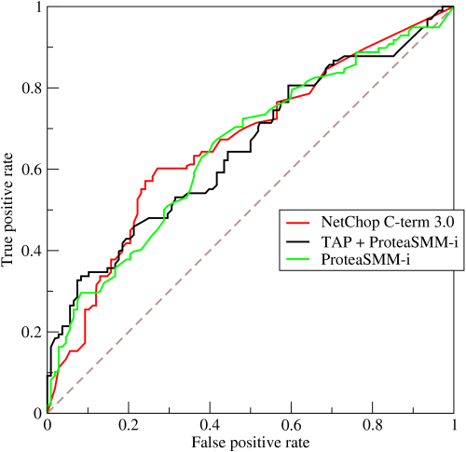
Receiver Operator Characteristic Curves
TPR = TP / (TP + FN)
FPR = FP / (FP + TN)
https://upload.wikimedia.org/wikipedia/commons/6/6b/Roccurves.png

Slide 21


Game time!
Two teams. Phones/computers away
Give each image a “cake score” of 0 (not likely to be cake) to 5 (super likely to be cake)
https://i.kym-cdn.com/entries/icons/original/000/001/707/thecakeisalie.jpg, https://dnm.nflximg.net/api/v6/2DuQlx0fM4wd1nzqm5BFBi6ILa8/AAAAQYwP3BYZ2Ri_-P-sY4_vtR9_fv6KPptWKKniY2_VxxOzqurvjAbe7bi4XPq2NbcH4vw99f1gFDyU_TZe7bkeHOBKNYccZkoFBoRsCHFtqWFtHPYk16RT26YMxUs8PffGpvROrvismA_Kt8PHRAuviZLp.jpg?r=b5e

Slide 22
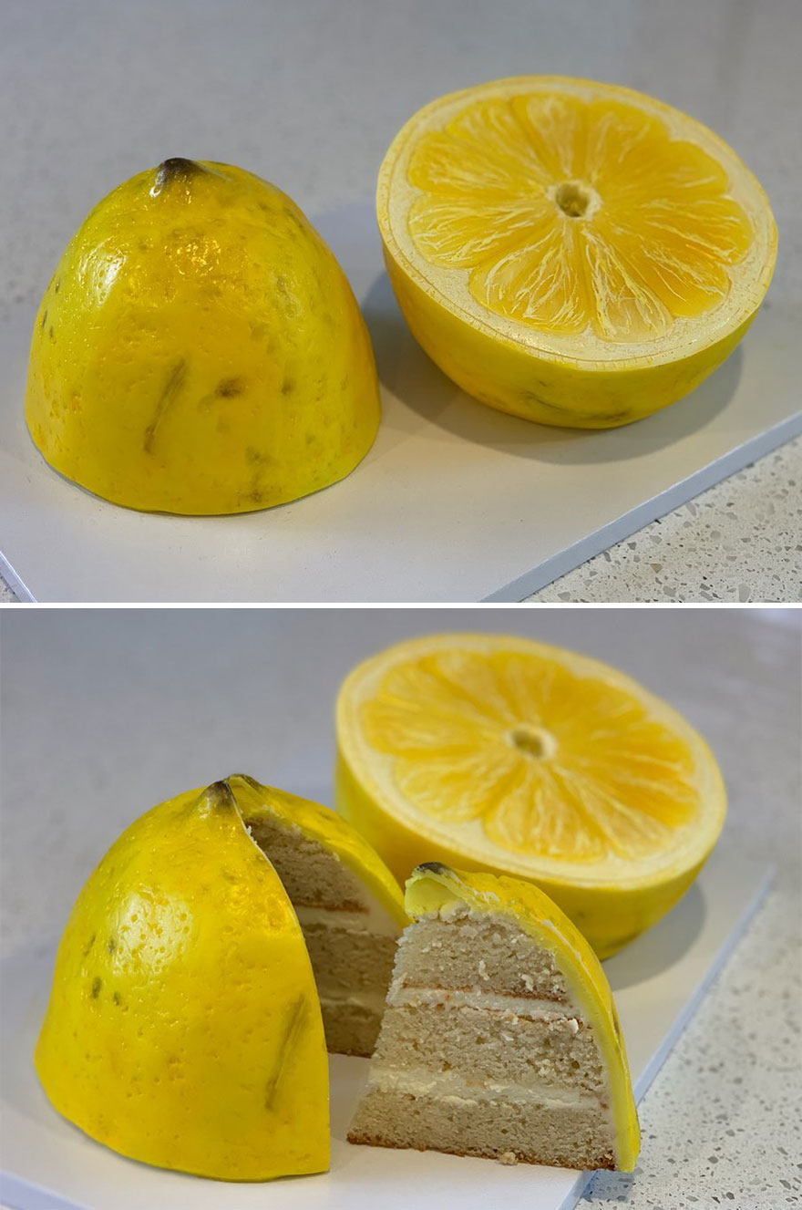
Is it cake? #1
https://static.boredpanda.com/blog/wp-content/uploads/2019/09/Artist-creates-hyper-realistic-cakes-inspired-by-objects-and-fruits-5d8869b5a64b7__880.jpg

Slide 23
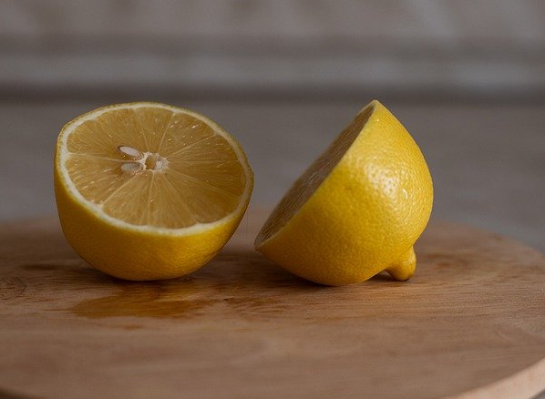
Is it cake? #2
https://cdn.pixabay.com/photo/2022/01/09/10/53/lemon-6925734_1280.jpg

Slide 24
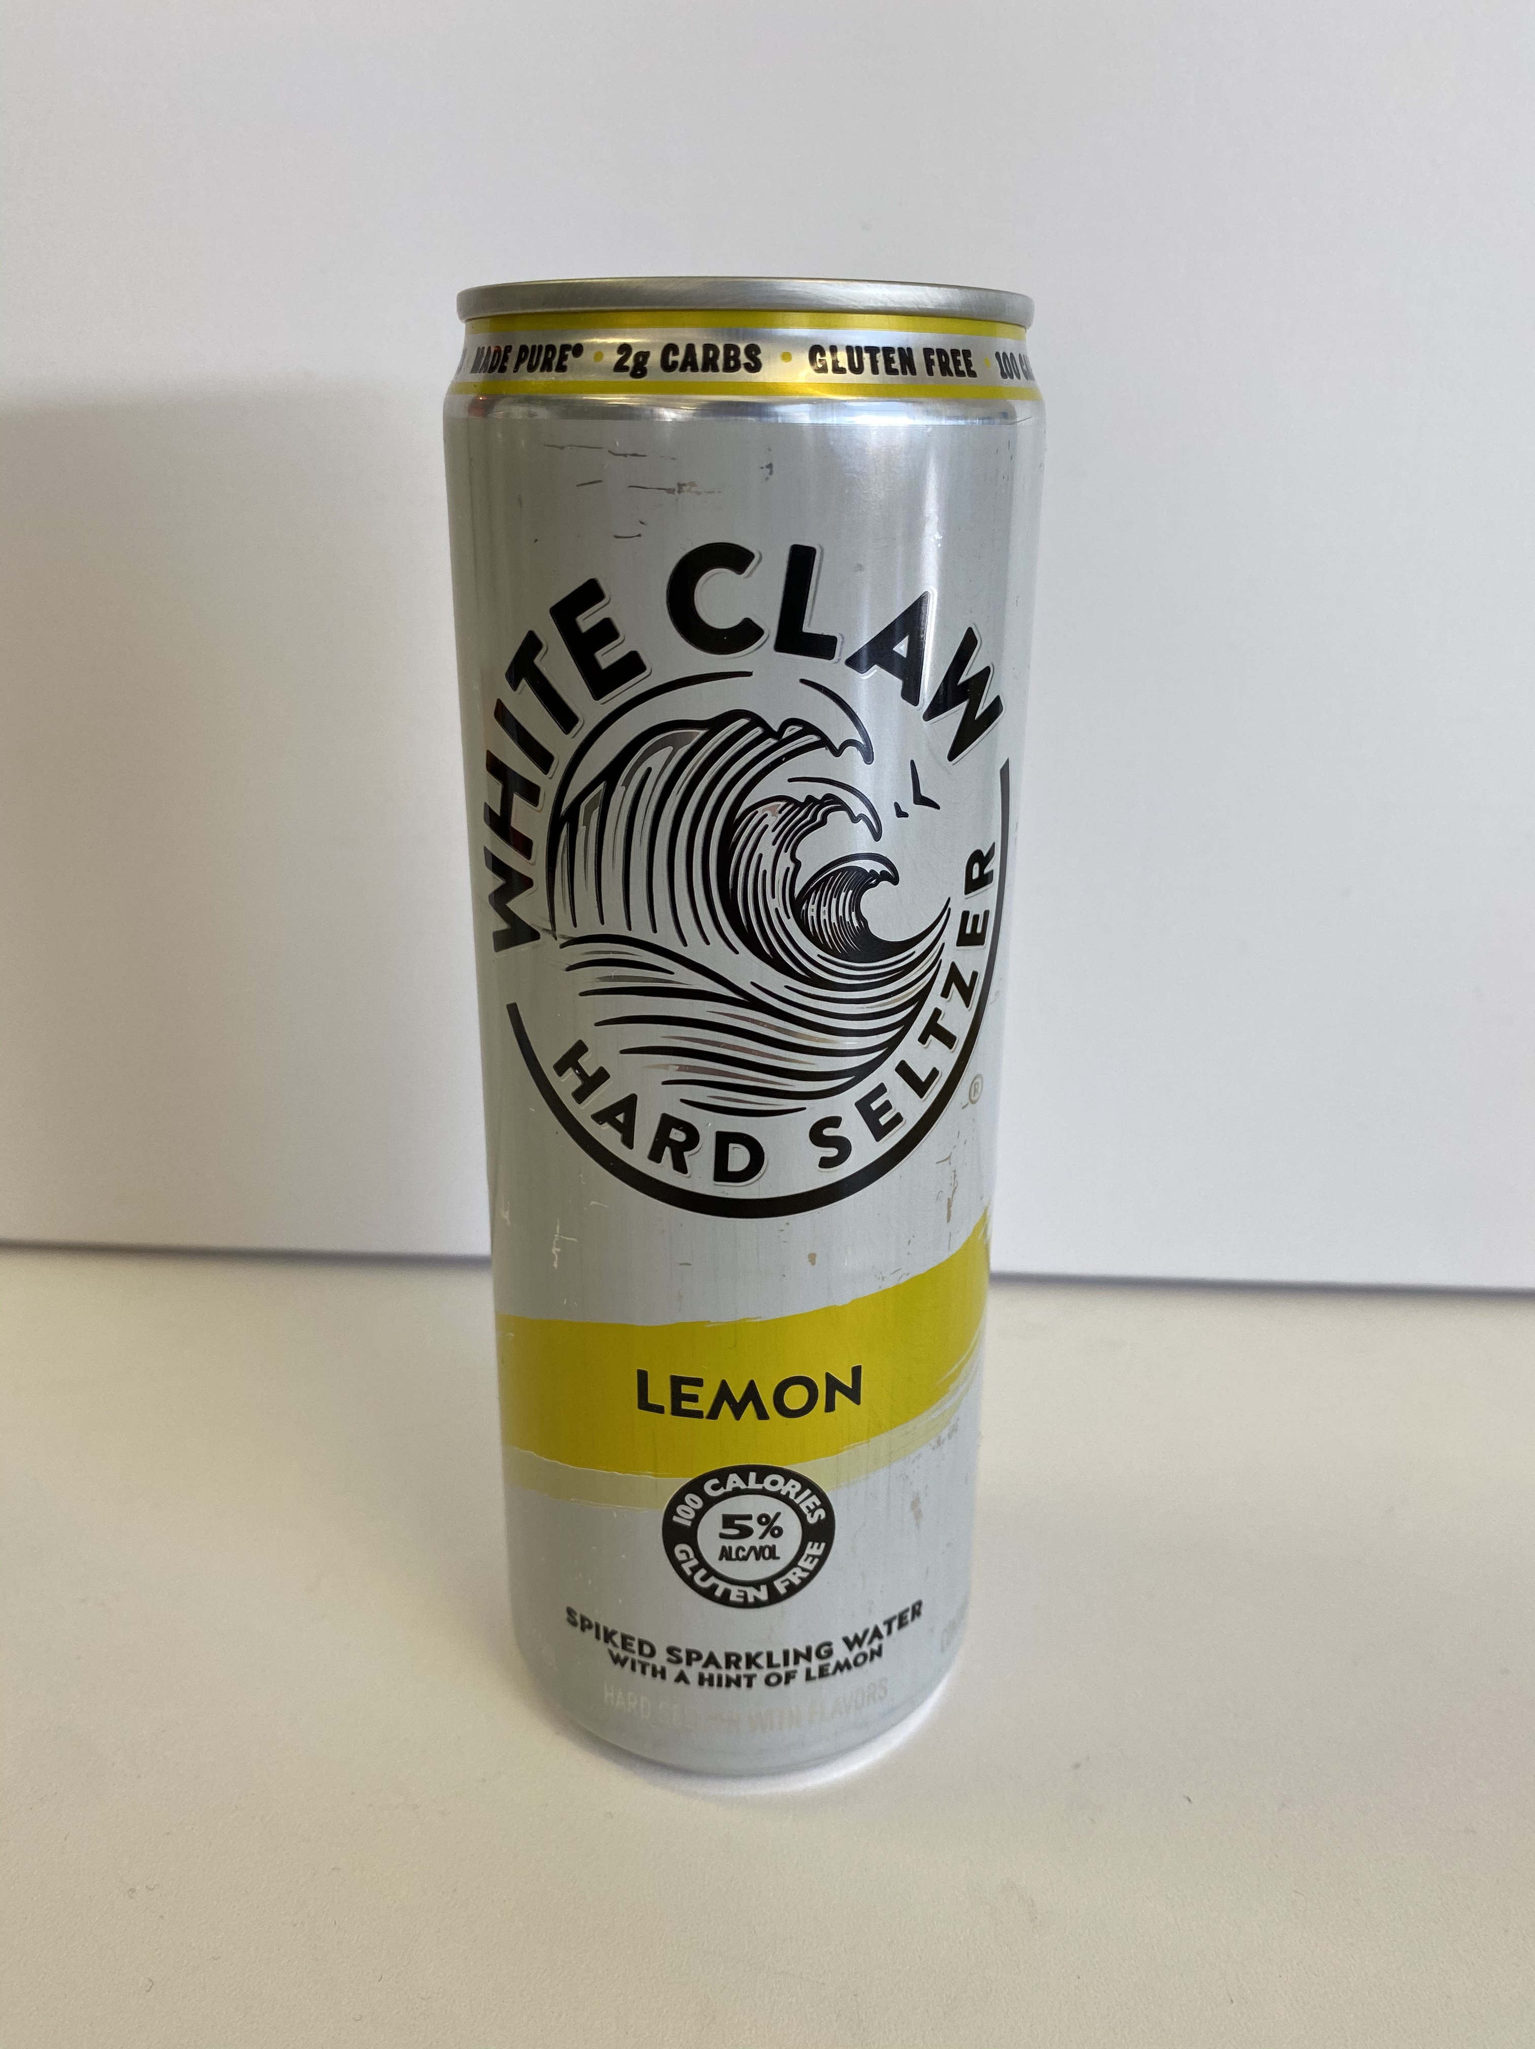
Is it cake? #3
https://cdn.apartmenttherapy.info/image/upload/v1582914079/k/Edit/IMG_1725.jpg

Slide 25
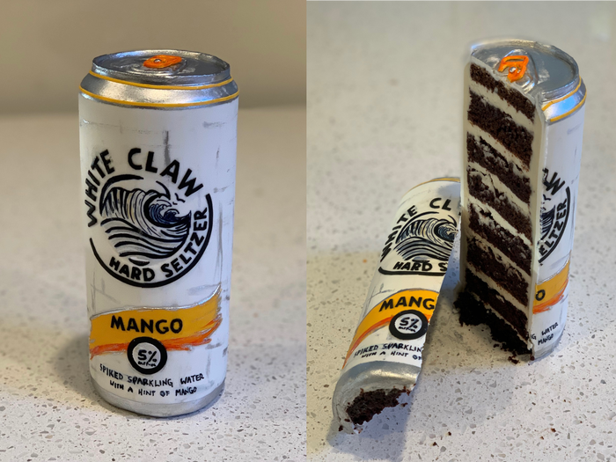
Is it cake? #4
https://i.insider.com/5d9c8d6c23f8645e02582215?width=1300&format=jpeg&auto=webp

Slide 26
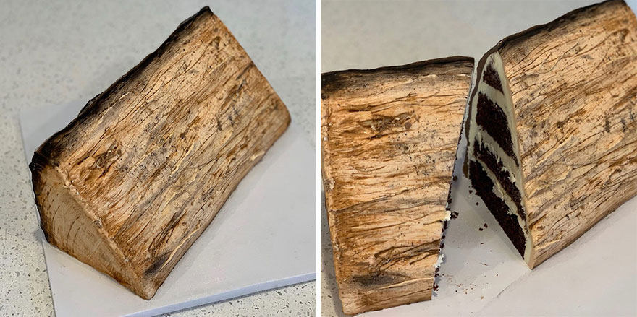
Is it cake? #5
https://static.boredpanda.com/blog/wp-content/uploads/2019/09/Artist-creates-hyper-realistic-cakes-inspired-by-objects-and-fruits-5d8869ba00e9f__880.jpg

Slide 27
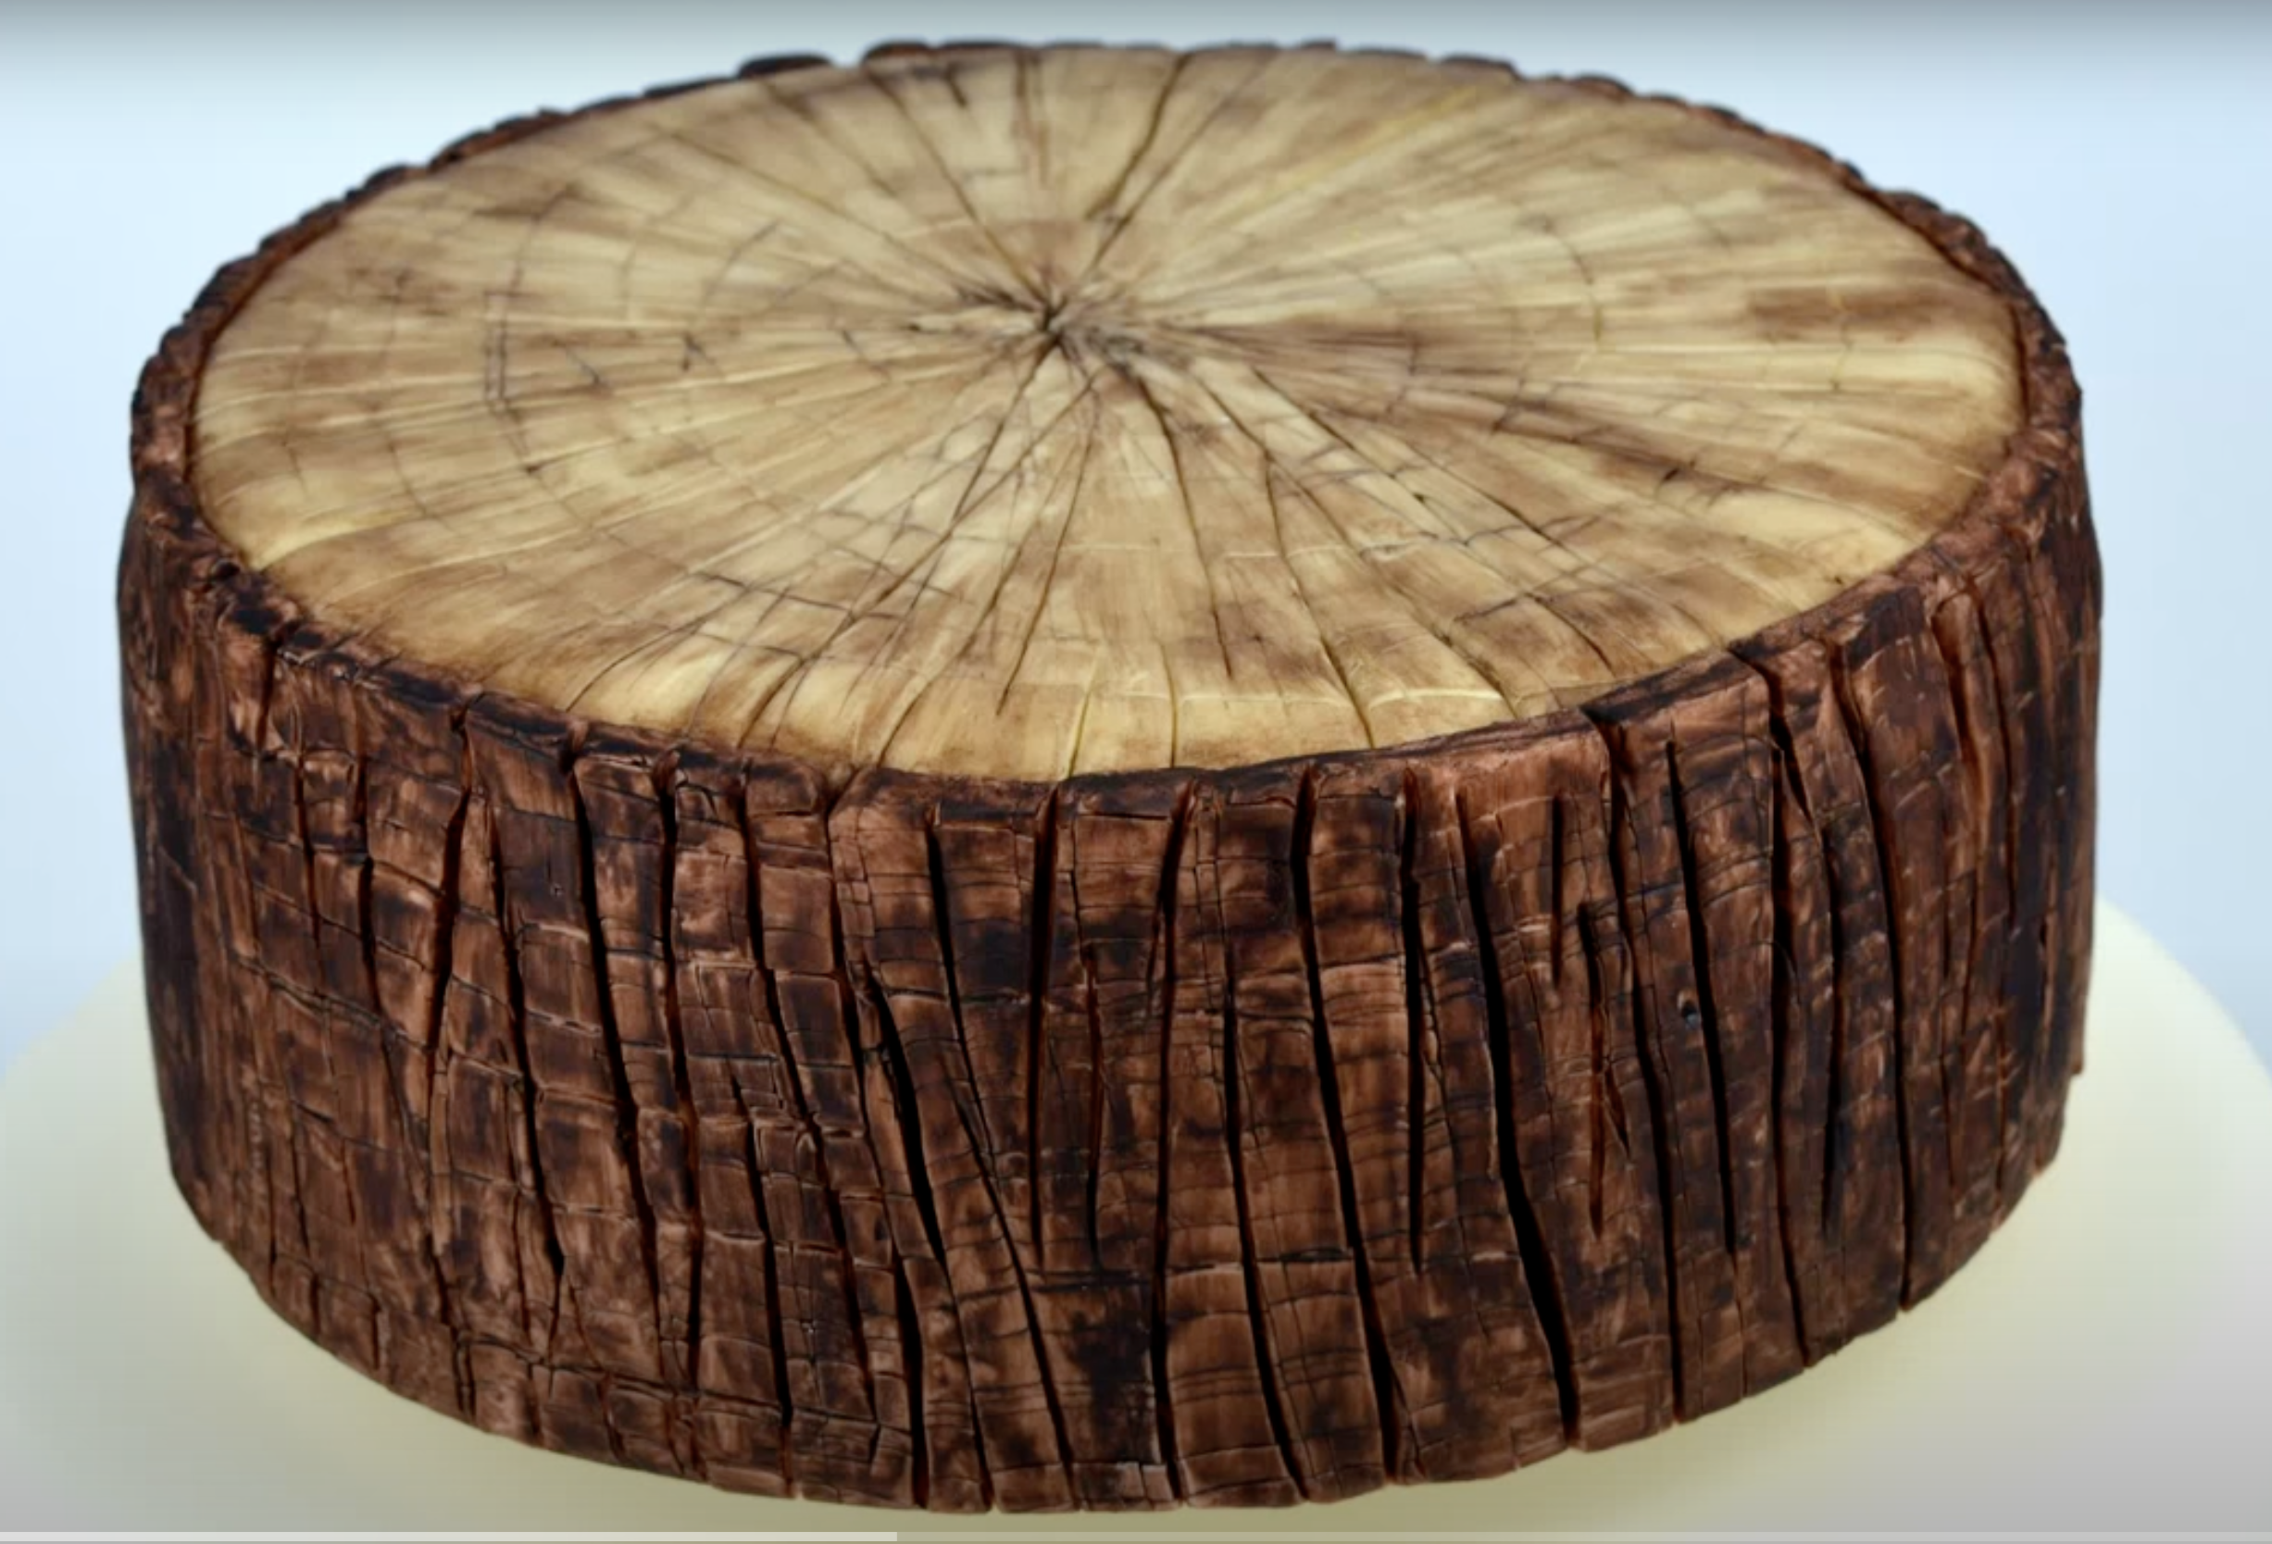
Is it cake? #6
https://www.youtube.com/watch?v=oZxCbuteM_4

Slide 28
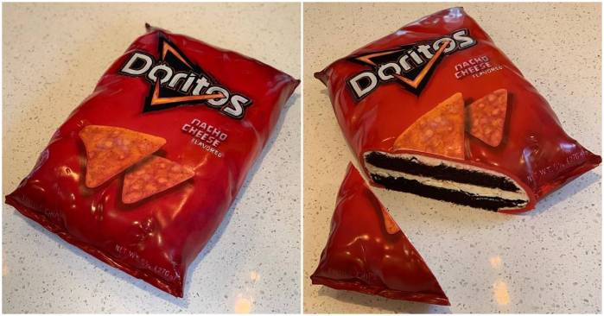
Is it cake? #7
https://i0.wp.com/awesomebyte.com/wp-content/uploads/2019/12/awesome-Cakes.jpg?w=1200&ssl=1

Slide 29
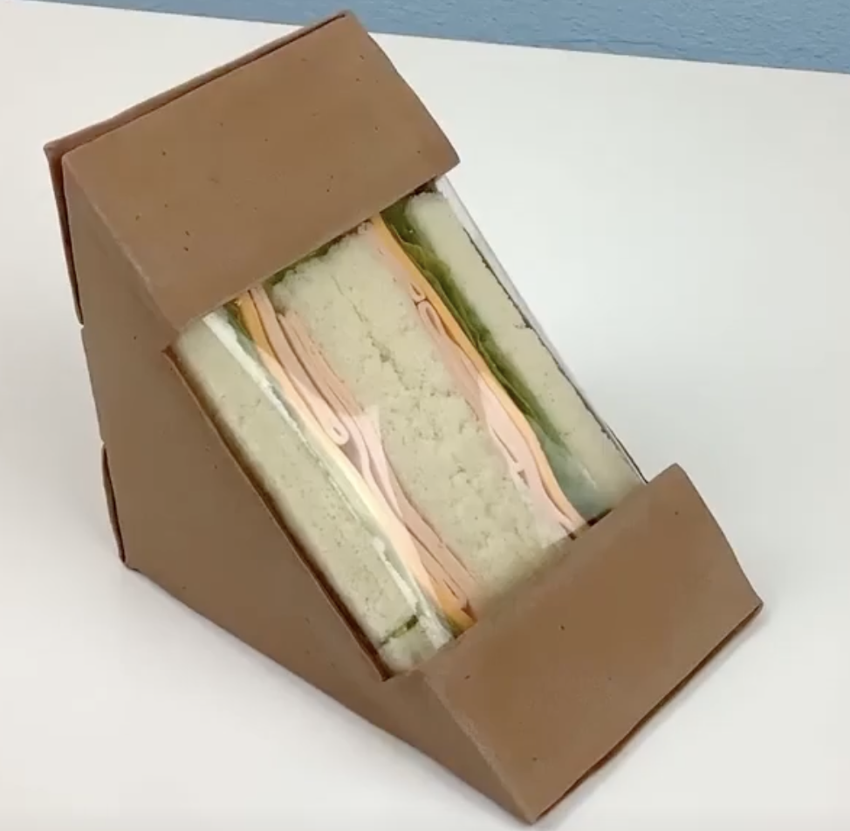
Is it cake? #8
https://www.unilad.co.uk/viral/womans-hyper-realistic-cakes-will-make-you-think-nothing-is-real

Slide 30
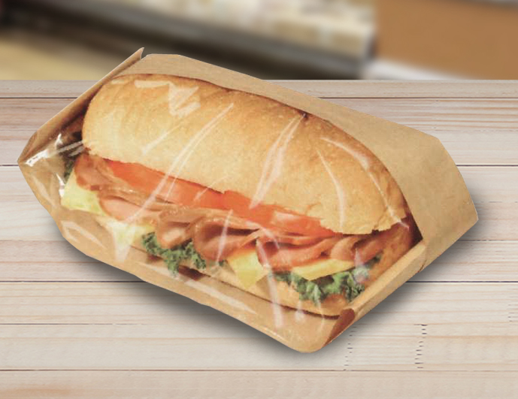
Is it cake? #9
https://www.google.com/url?sa=i&url=https%3A%2F%2Fwww.brenmarco.com%2Fproduct%2Fdubl-viewe-sandwich-bag-natural%2F&psig=AOvVaw2fYNNYMcieaqddoPlOZjLm&ust=1649908496451000&source=images&cd=vfe&ved=0CAoQjRxqFwoTCMjNxKCSkPcCFQAAAAAdAAAAABAR

Slide 31
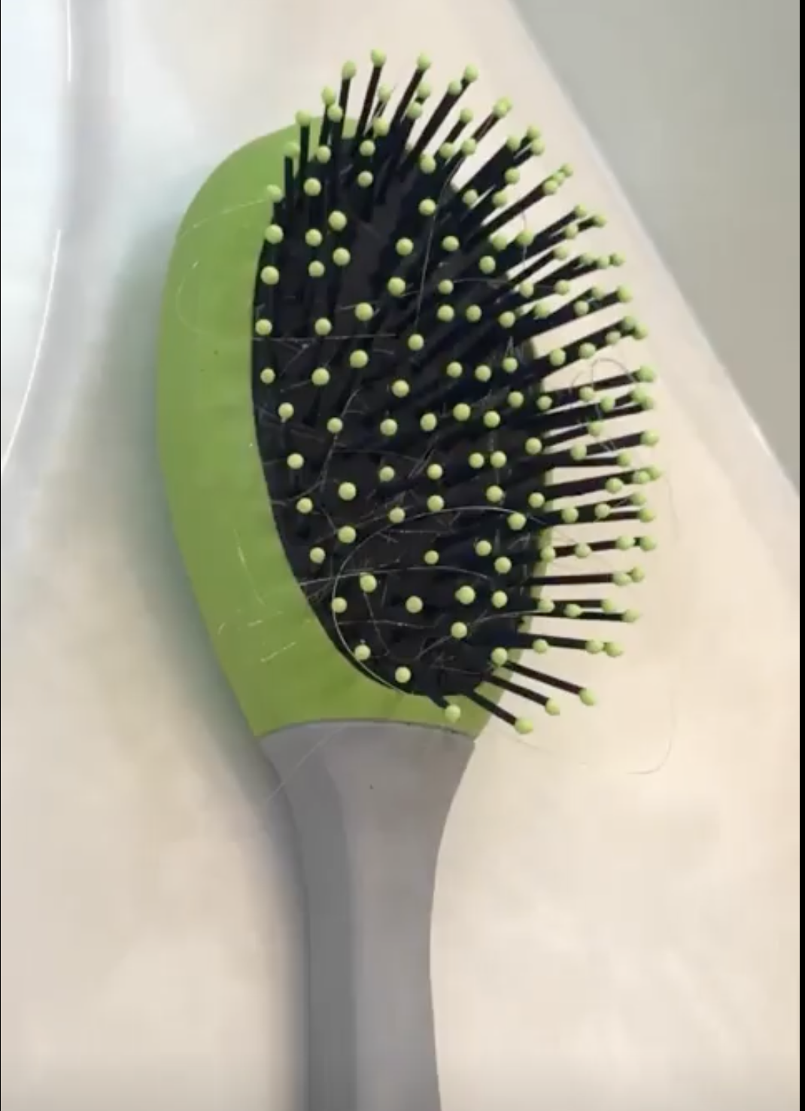
Is it cake? #10
https://www.unilad.co.uk/viral/womans-hyper-realistic-cakes-will-make-you-think-nothing-is-real

Slide 32
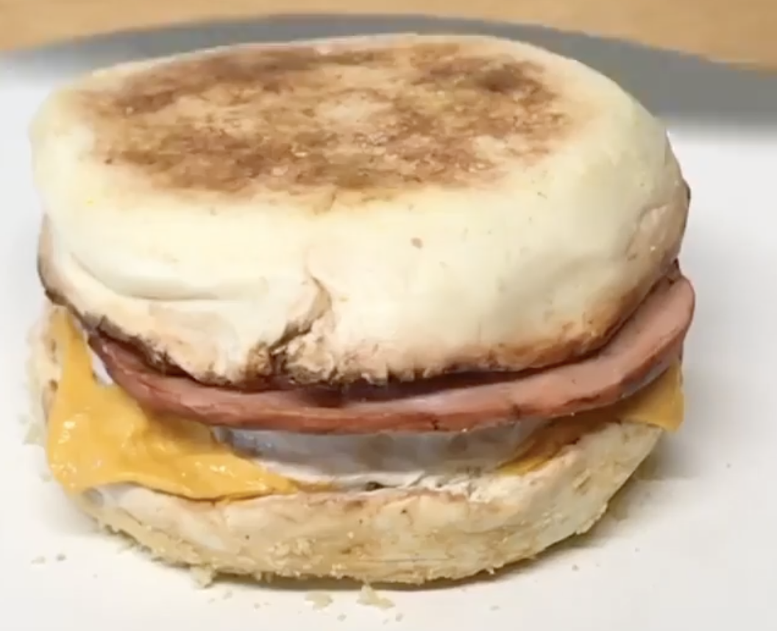
Is it cake? #11
https://www.unilad.co.uk/viral/womans-hyper-realistic-cakes-will-make-you-think-nothing-is-real

Slide 33
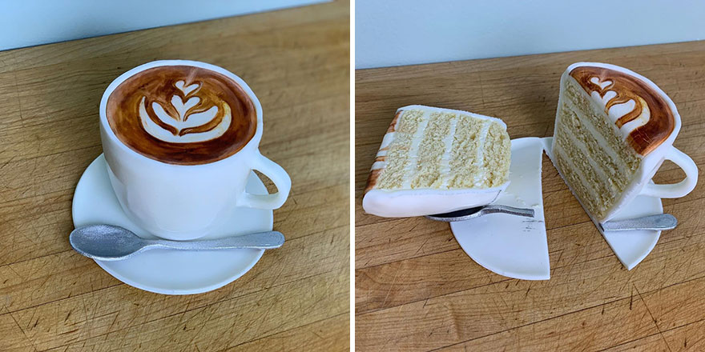
Is it cake? #12
https://static.boredpanda.com/blog/wp-content/uploads/2019/09/Artist-creates-hyper-realistic-cakes-inspired-by-objects-and-fruits-5d8869a2cf11c__880.jpg

Slide 34
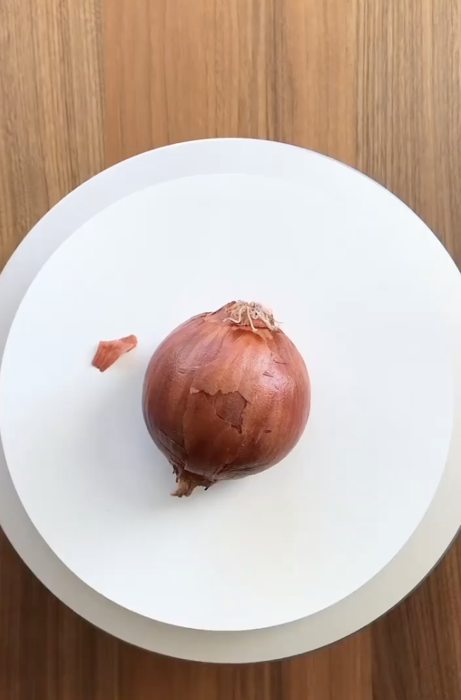
Is it cake? #13
https://www.instagram.com/p/CVN2X1TtwTA/?utm_source=ig_embed&utm_campaign=embed_video_watch_again

Slide 35
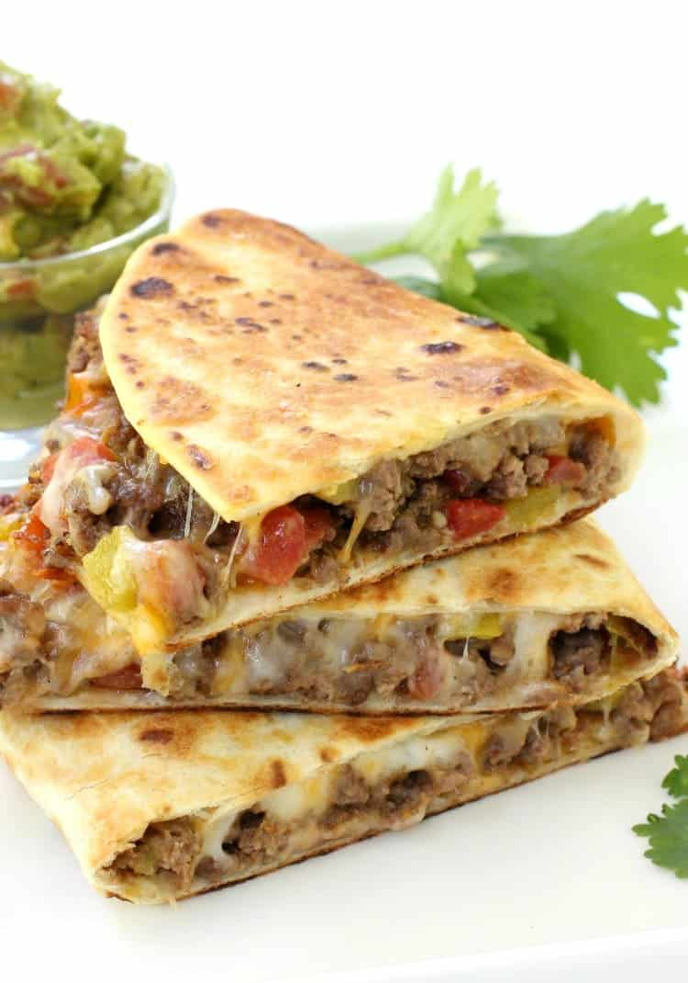
Is it cake? #14
https://www.mantitlement.com/wp-content/uploads/2016/07/pan-fried-beef-tacos-stacked-vert.jpg

Slide 36
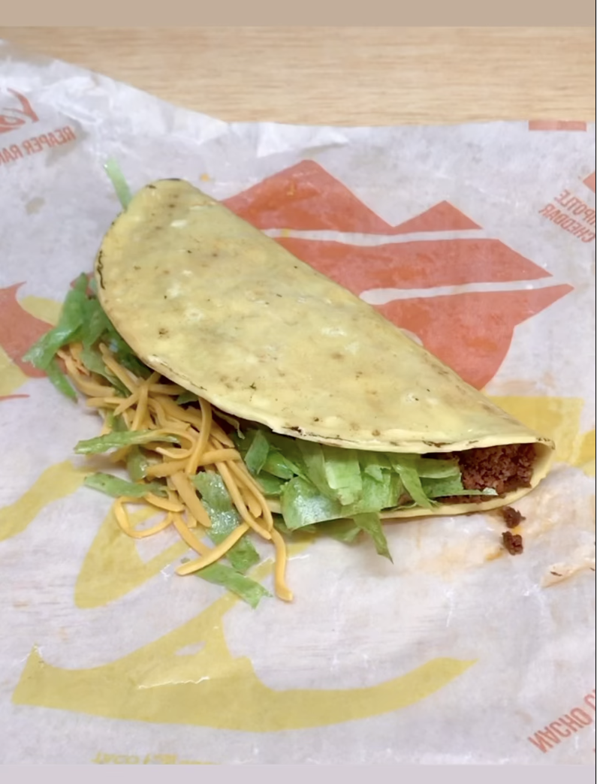
Is it cake? #15
https://www.instagram.com/p/Cb5EG01JfJC/

Slide 37
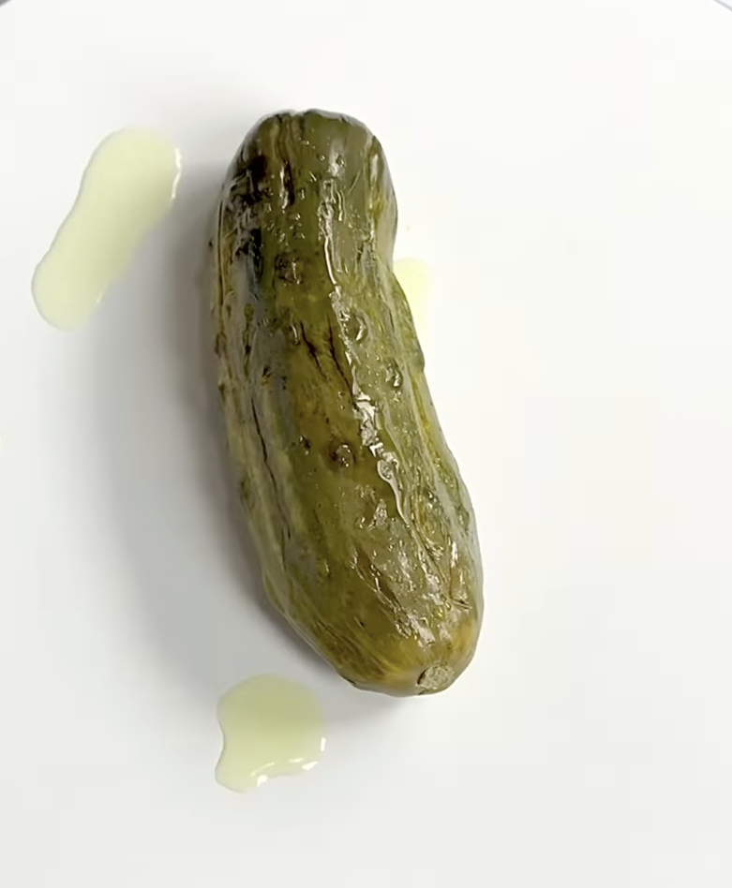
Is it cake? #16
https://www.instagram.com/p/CY4AFYVlhB7/

Slide 38
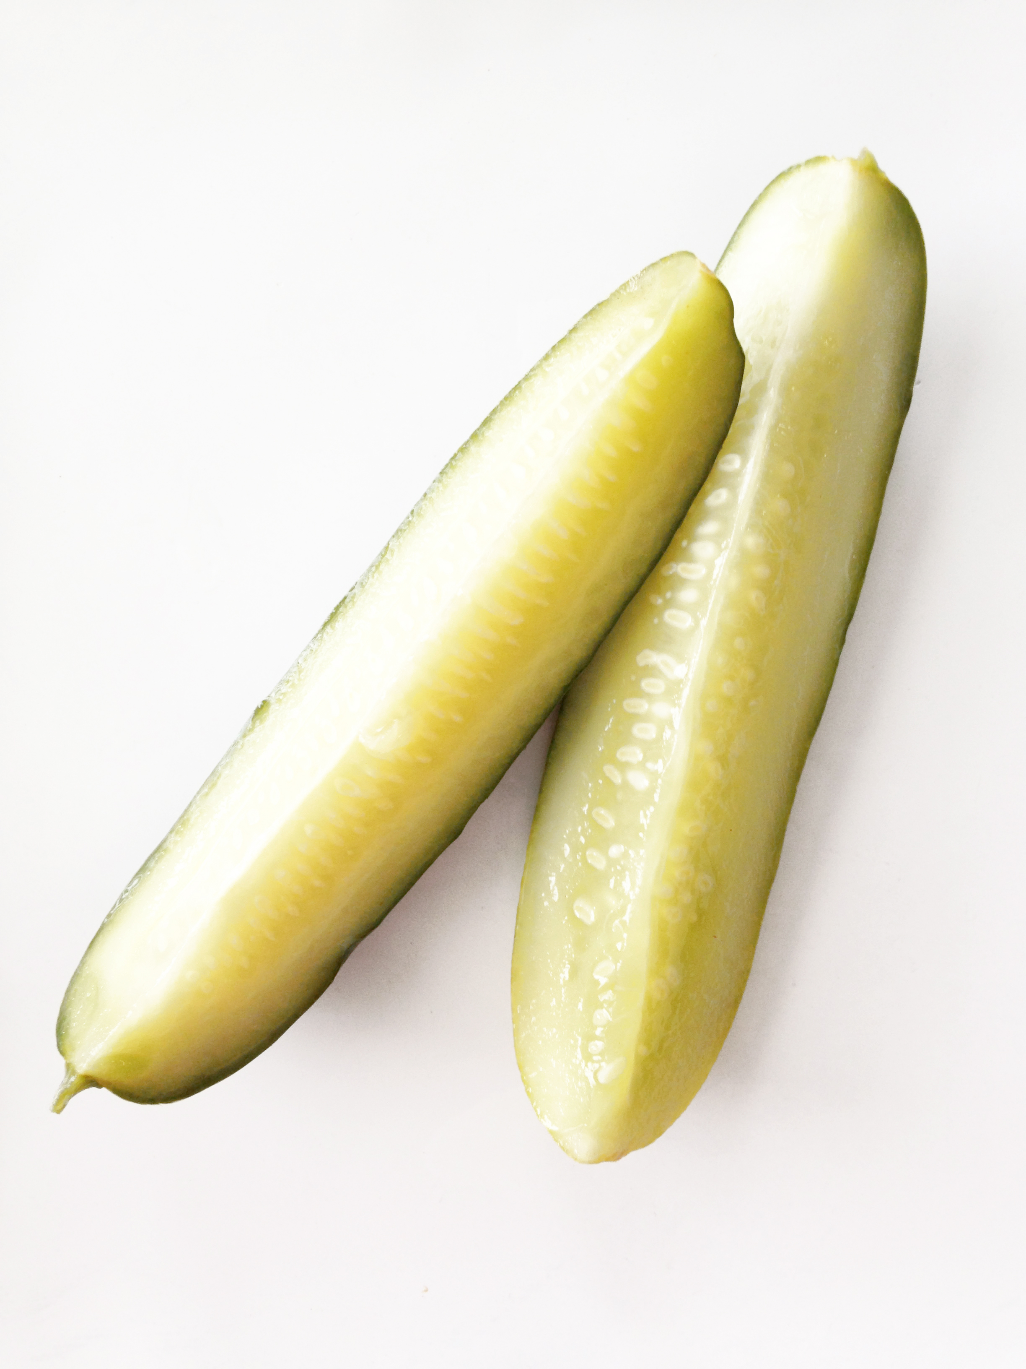
Is it cake? #17
https://images.squarespace-cdn.com/content/v1/5113fcede4b099bd04eebc8d/1409757529299-MONGSWKRNPCBSBMG5AAH/Photo+Sep+03%2C+9+47+49+AM.jpg

Slide 39
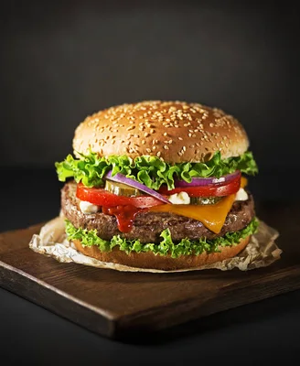
Is it cake? #18
https://st4.depositphotos.com/1009628/20306/i/600/depositphotos_203067720-stock-photo-homemade-hamburger-burger-fresh-vegetables.jpg

Slide 40
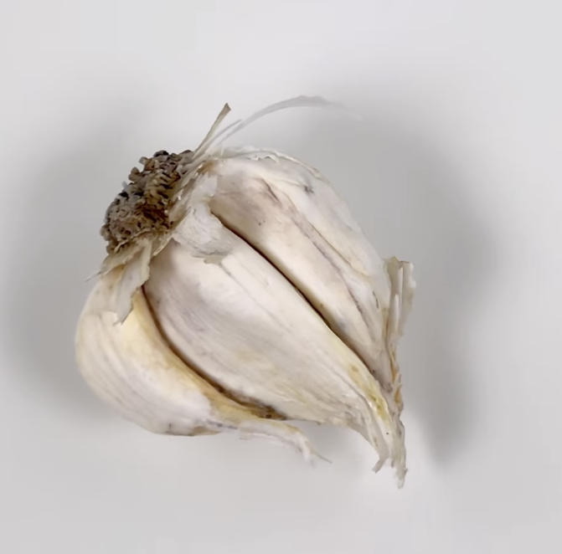
Is it cake? #19
https://www.instagram.com/p/Cb7nIAMl-RM/

Slide 41
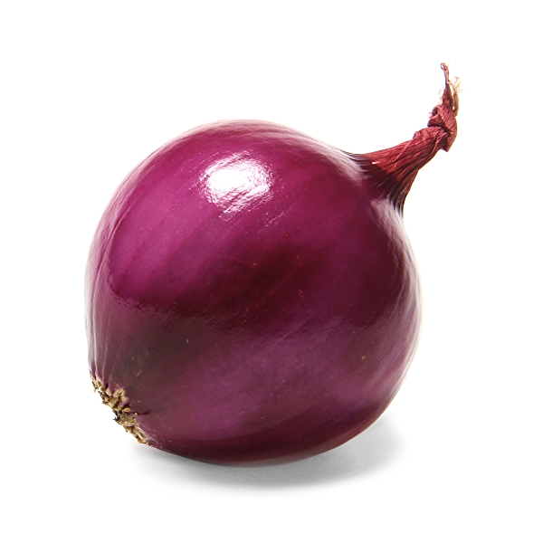
Is it cake? #20
https://m.media-amazon.com/images/S/assets.wholefoodsmarket.com/PIE/product/575f28f7c8ecc79afb742996_produce_redonions.1._TTD_._SR600,600_._QL100_.jpg

Slide 42
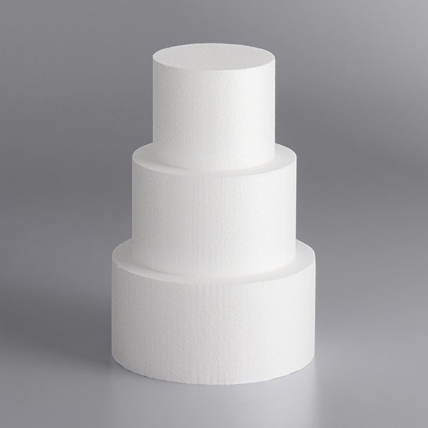
Is it cake? #21
https://cdnimg.webstaurantstore.com/images/products/large/527685/1949373.jpg

Slide 43
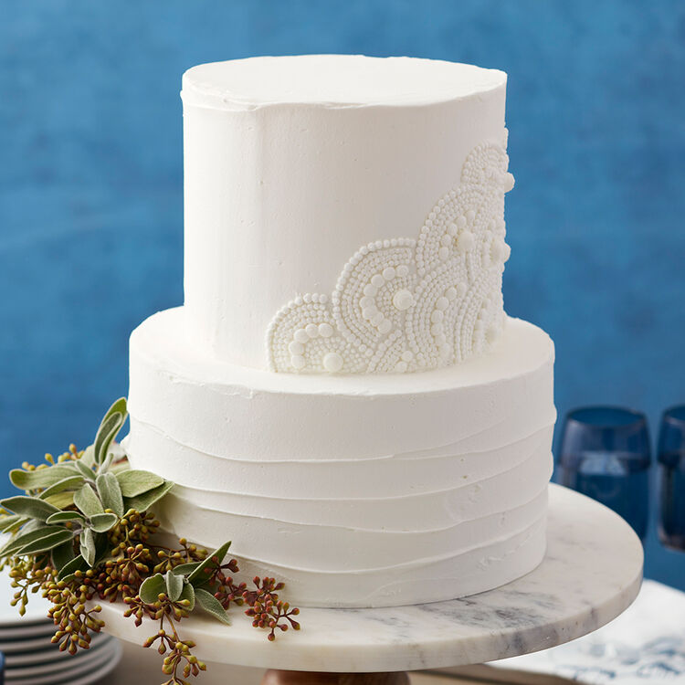
Is it cake? #22
https://www.wilton.com/dw/image/v2/AAWA_PRD/on/demandware.static/-/Sites-wilton-project-master/default/dw91adac21/images/project/WLPROJ-8535/Scalloped-White-Wedding-Cake.jpg?sw=1440&sh=750&sm=fit

Slide 44
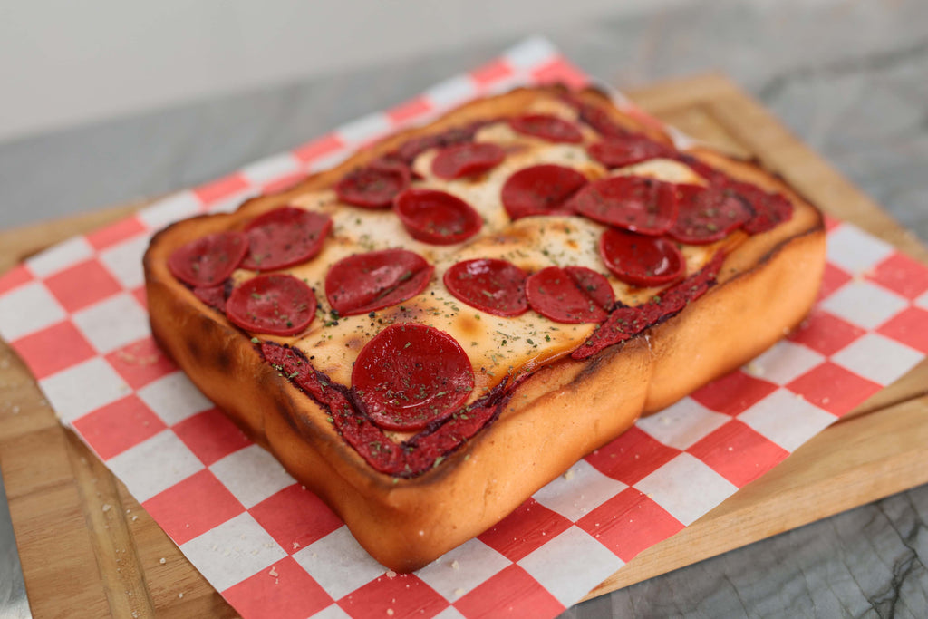
Is it cake? #23
https://www.google.com/url?sa=i&url=https%3A%2F%2Frosannapansino.com%2Fblogs%2Frecipes%2Fhyper-realistic-pizza-cake&psig=AOvVaw0Mgn7YBWYlWA8Lz4AmbLWt&ust=1681257781396000&source=images&cd=vfe&ved=0CBAQjRxqFwoTCJCtsrvDoP4CFQAAAAAdAAAAABAD

Slide 45
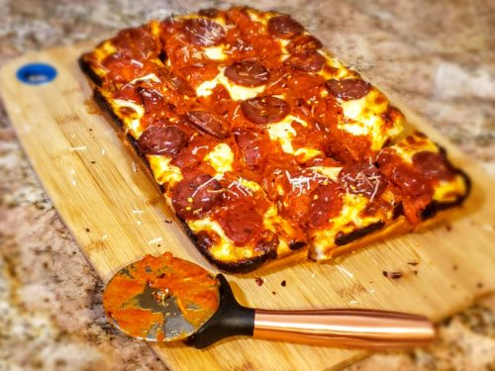
Is it cake? #24
https://www.google.com/url?sa=i&url=https%3A%2F%2Fflavorbible.com%2F2020%2F05%2F26%2Fdetroit-style-pizza%2F&psig=AOvVaw0By-AlL_n2C9whN9CC2E5C&ust=1681257987653000&source=images&cd=vfe&ved=0CBAQjRxqFwoTCLCpwanEoP4CFQAAAAAdAAAAABAS

Slide 47
#1: It’s cake!
https://static.boredpanda.com/blog/wp-content/uploads/2019/09/Artist-creates-hyper-realistic-cakes-inspired-by-objects-and-fruits-5d8869b5a64b7__880.jpg

Slide 48
#2: Not cake!
https://cdn.pixabay.com/photo/2022/01/09/10/53/lemon-6925734_1280.jpg

Slide 49
#3: Not cake!
https://cdn.apartmenttherapy.info/image/upload/v1582914079/k/Edit/IMG_1725.jpg

Slide 50
#4: It’s cake!
https://i.insider.com/5d9c8d6c23f8645e02582215?width=1300&format=jpeg&auto=webp

Slide 51
#5: It’s cake!
https://static.boredpanda.com/blog/wp-content/uploads/2019/09/Artist-creates-hyper-realistic-cakes-inspired-by-objects-and-fruits-5d8869ba00e9f__880.jpg

Slide 52
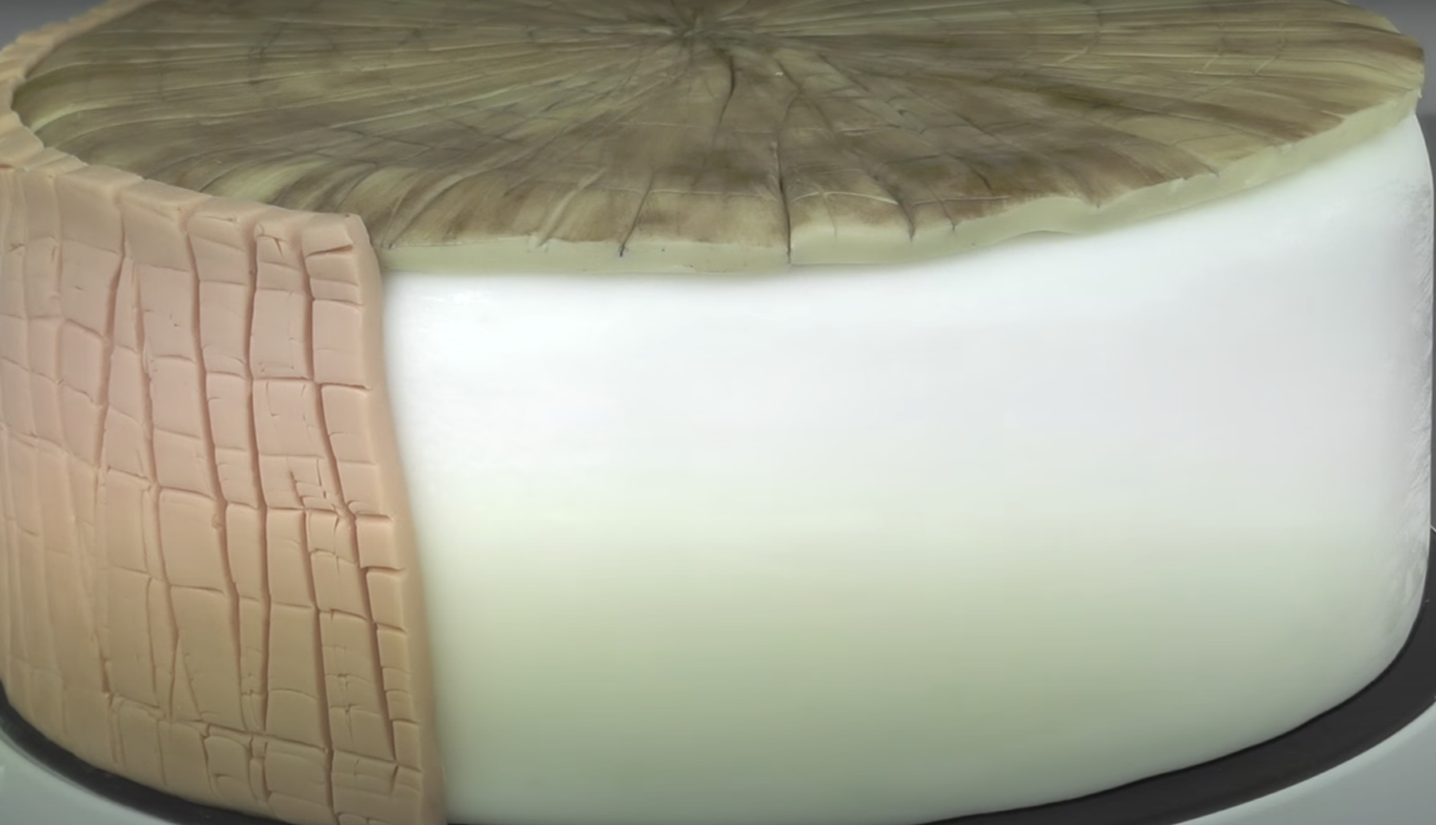
#6: It’s cake!
https://www.youtube.com/watch?v=oZxCbuteM_4

Slide 53
#7: It’s cake!
https://i0.wp.com/awesomebyte.com/wp-content/uploads/2019/12/awesome-Cakes.jpg?w=1200&ssl=1

Slide 54
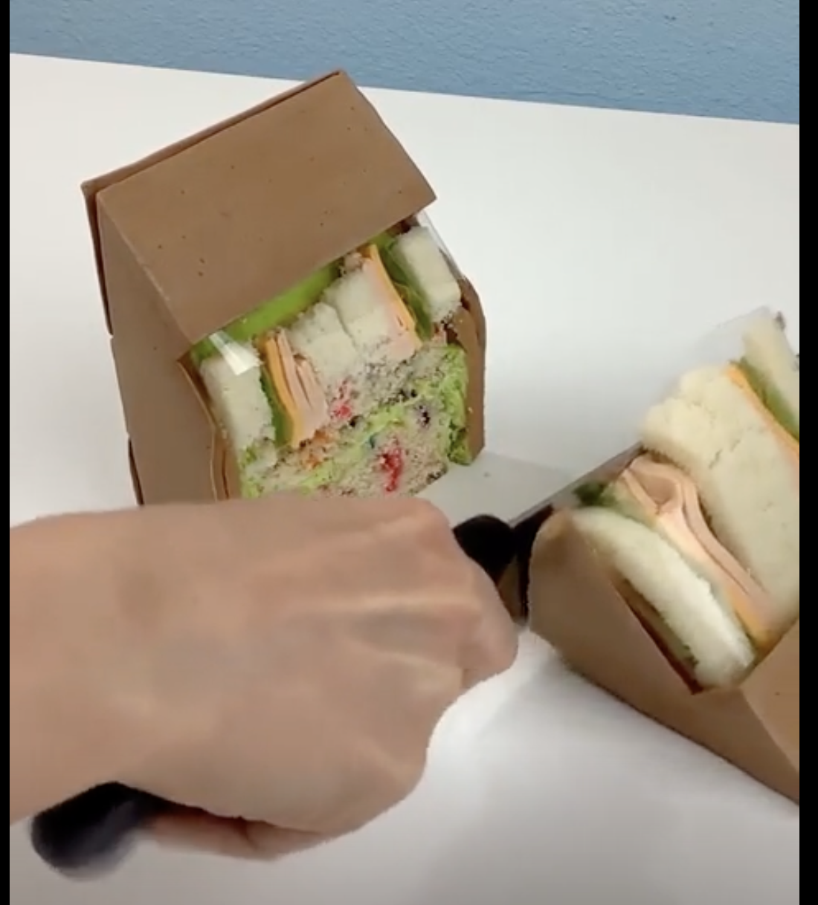
#8: It’s cake!
https://www.unilad.co.uk/viral/womans-hyper-realistic-cakes-will-make-you-think-nothing-is-real

Slide 55
#9: Not cake!
https://www.google.com/url?sa=i&url=https%3A%2F%2Fwww.brenmarco.com%2Fproduct%2Fdubl-viewe-sandwich-bag-natural%2F&psig=AOvVaw2fYNNYMcieaqddoPlOZjLm&ust=1649908496451000&source=images&cd=vfe&ved=0CAoQjRxqFwoTCMjNxKCSkPcCFQAAAAAdAAAAABAR

Slide 56
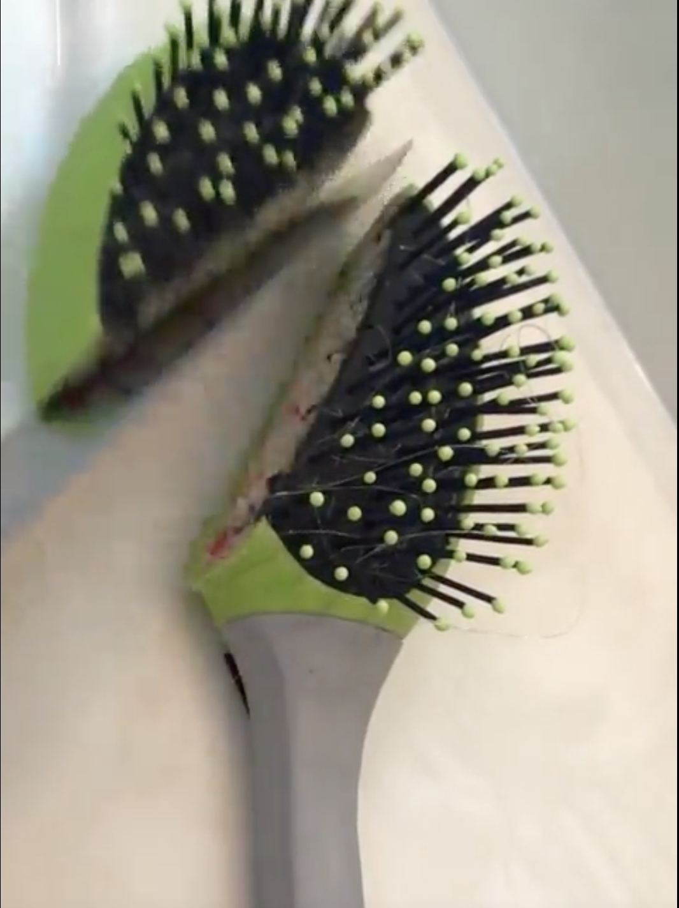
#10: It’s cake!
https://www.unilad.co.uk/viral/womans-hyper-realistic-cakes-will-make-you-think-nothing-is-real

Slide 57
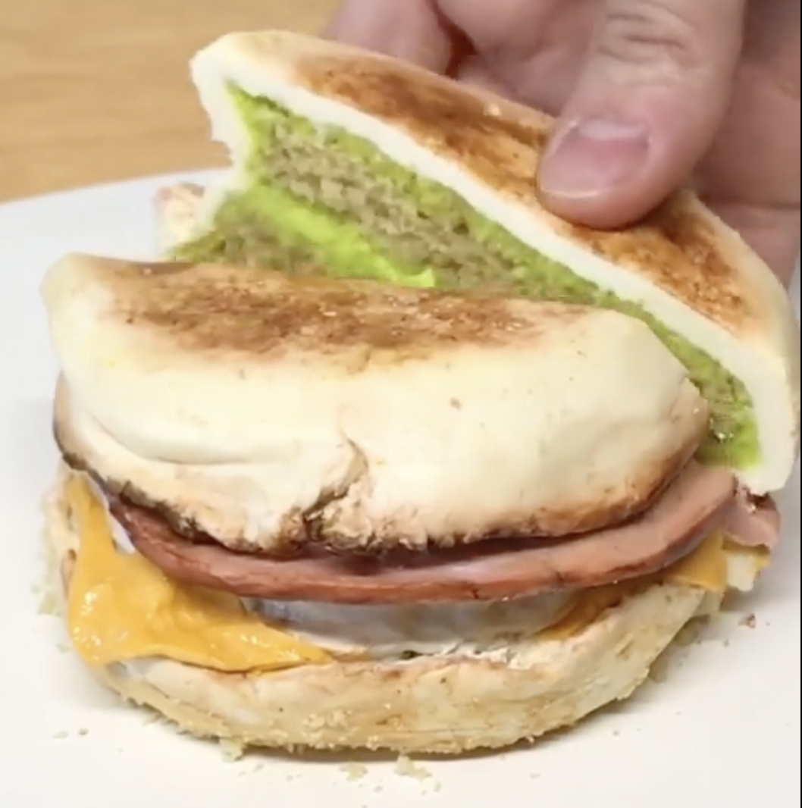
#11: It’s cake!
https://www.unilad.co.uk/viral/womans-hyper-realistic-cakes-will-make-you-think-nothing-is-real

Slide 58
#12: It’s cake!
https://static.boredpanda.com/blog/wp-content/uploads/2019/09/Artist-creates-hyper-realistic-cakes-inspired-by-objects-and-fruits-5d8869a2cf11c__880.jpg

Slide 59
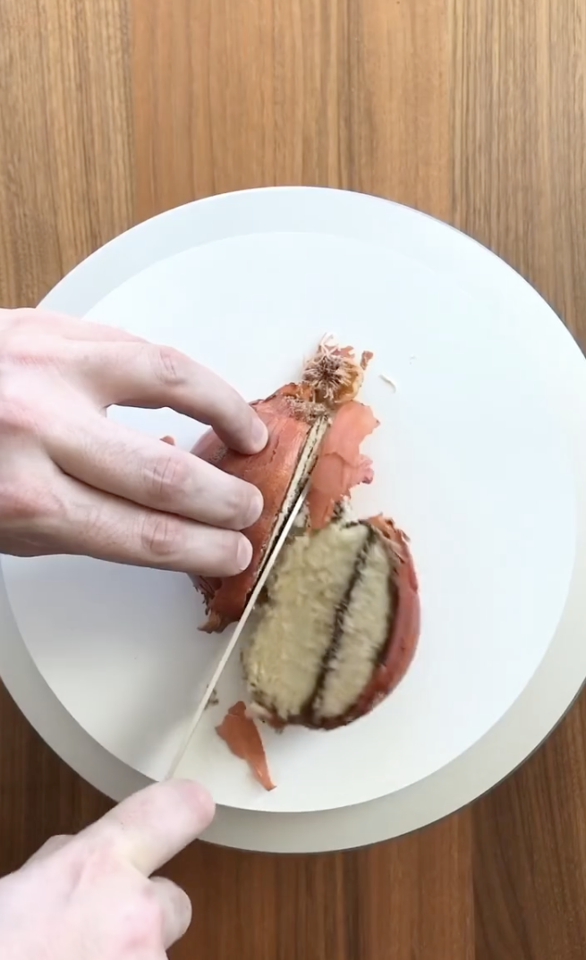
#13: It’s cake!
https://www.instagram.com/p/CVN2X1TtwTA/?utm_source=ig_embed&utm_campaign=embed_video_watch_again

Slide 60
#14: Not cake!
https://www.mantitlement.com/wp-content/uploads/2016/07/pan-fried-beef-tacos-stacked-vert.jpg

Slide 61
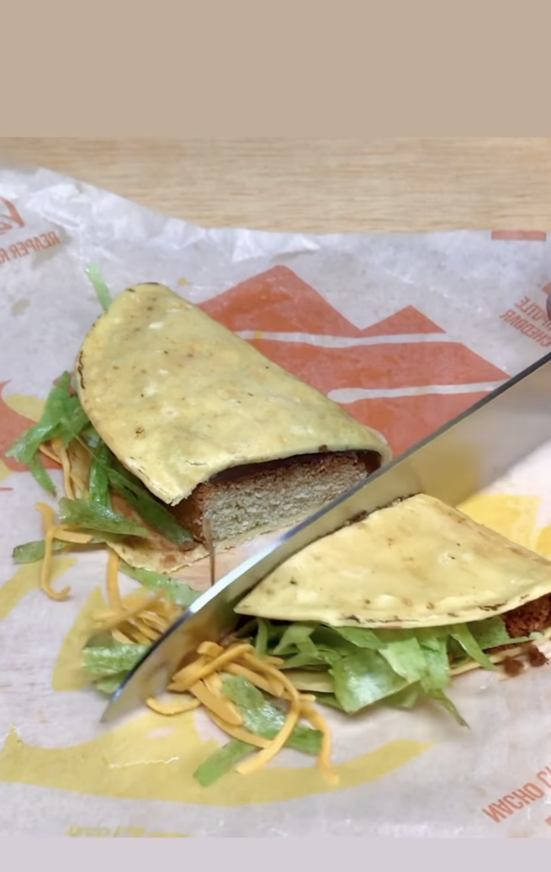
#15: It’s cake!
https://www.instagram.com/p/Cb5EG01JfJC/

Slide 62
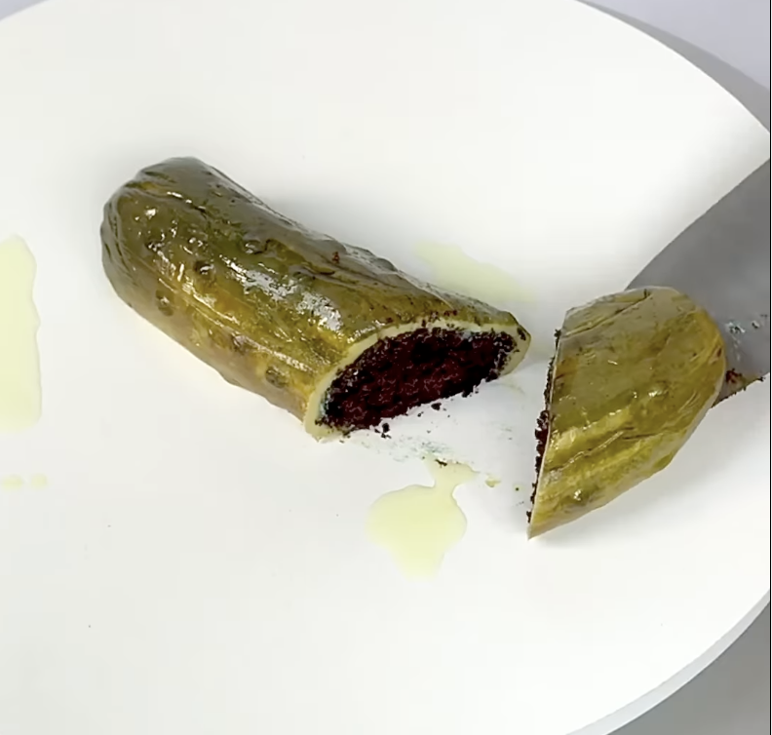
#16: It’s cake!
https://www.instagram.com/p/CY4AFYVlhB7/

Slide 63
#17: Not cake!
https://images.squarespace-cdn.com/content/v1/5113fcede4b099bd04eebc8d/1409757529299-MONGSWKRNPCBSBMG5AAH/Photo+Sep+03%2C+9+47+49+AM.jpg

Slide 64
#18: Not cake!
https://st4.depositphotos.com/1009628/20306/i/600/depositphotos_203067720-stock-photo-homemade-hamburger-burger-fresh-vegetables.jpg

Slide 65
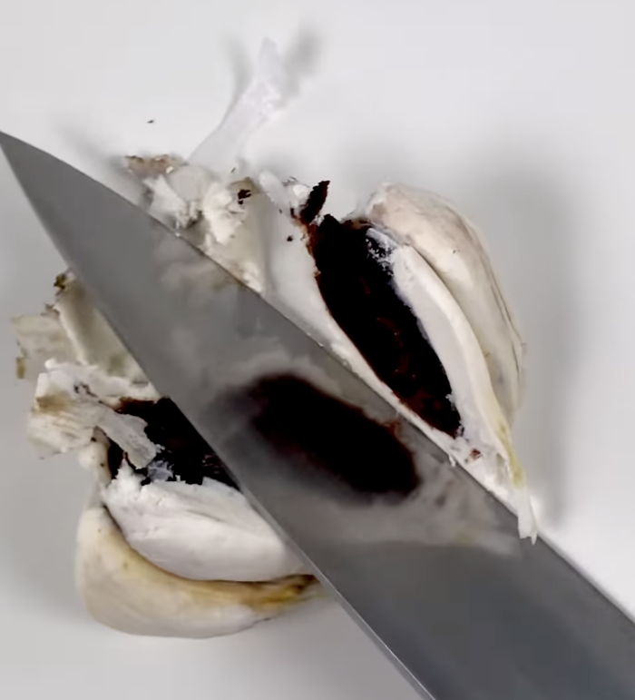
#19: It’s cake!
https://www.instagram.com/p/Cb7nIAMl-RM/

Slide 66
#20: Not cake!
https://m.media-amazon.com/images/S/assets.wholefoodsmarket.com/PIE/product/575f28f7c8ecc79afb742996_produce_redonions.1._TTD_._SR600,600_._QL100_.jpg

Slide 67
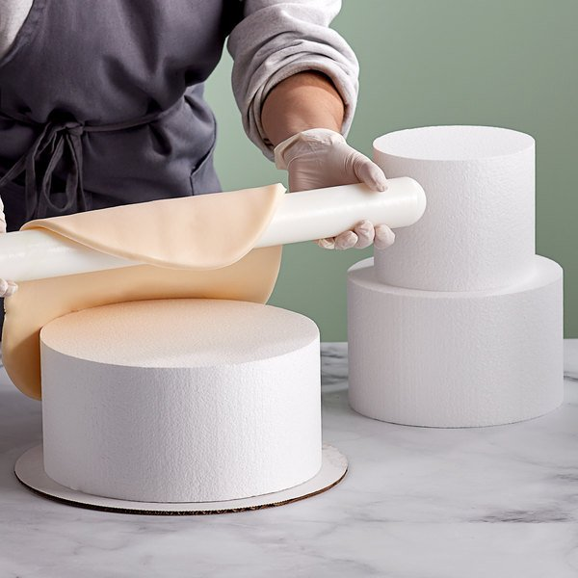
#21: Not cake!
https://cdnimg.webstaurantstore.com/images/products/large/527685/1949374.jpg

Slide 68
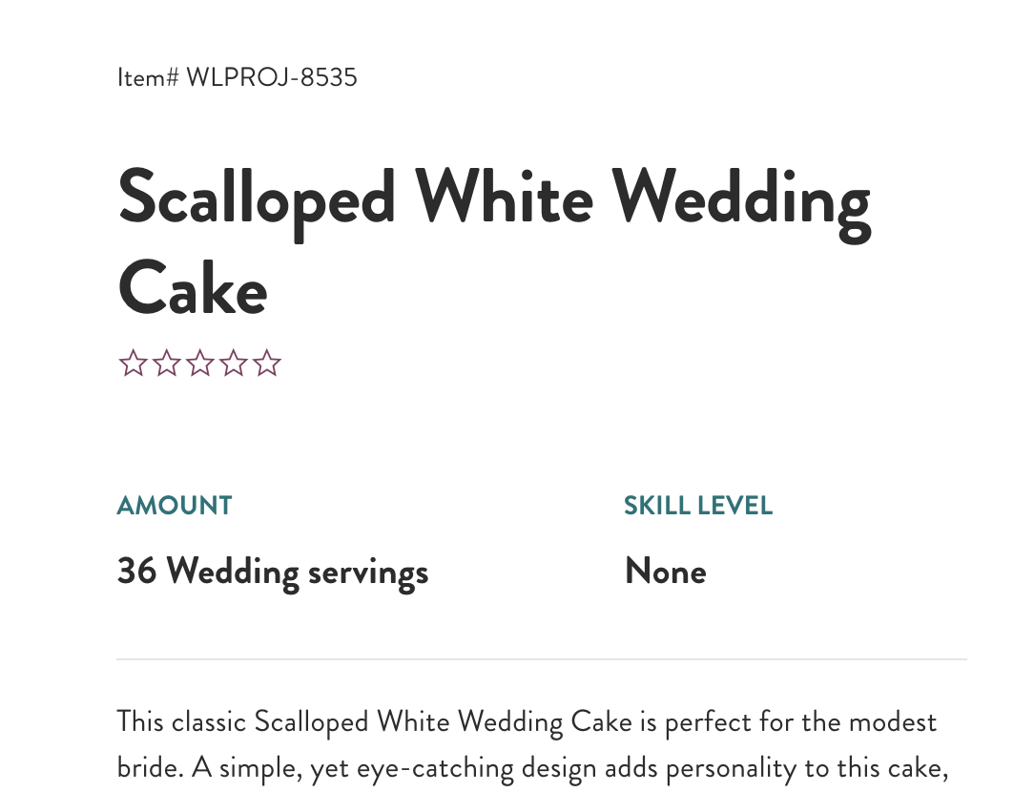
#22: It’s cake!
https://www.wilton.com/dw/image/v2/AAWA_PRD/on/demandware.static/-/Sites-wilton-project-master/default/dw91adac21/images/project/WLPROJ-8535/Scalloped-White-Wedding-Cake.jpg?sw=1440&sh=750&sm=fit

Slide 69
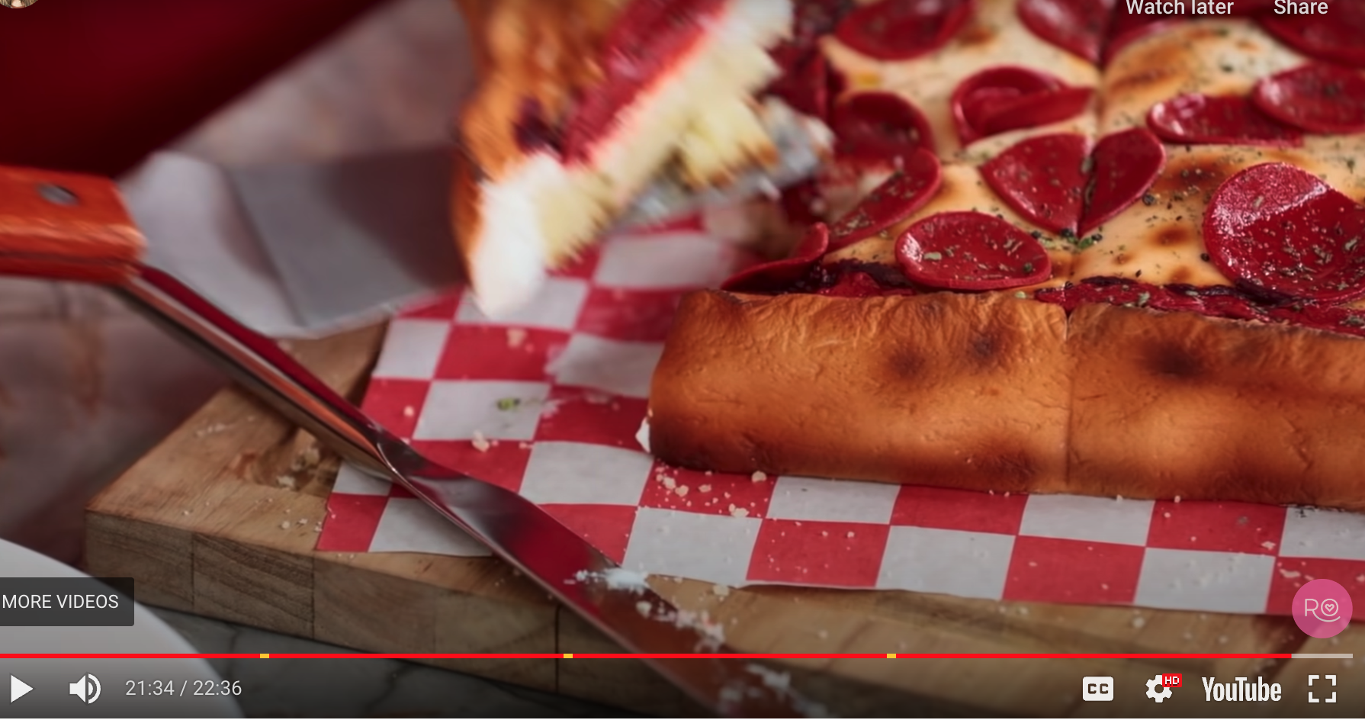
#23: It’s cake!
https://rosannapansino.com/blogs/recipes/hyper-realistic-pizza-cake

Slide 70
#24: Not cake!
https://www.google.com/url?sa=i&url=https%3A%2F%2Fflavorbible.com%2F2020%2F05%2F26%2Fdetroit-style-pizza%2F&psig=AOvVaw0By-AlL_n2C9whN9CC2E5C&ust=1681257987653000&source=images&cd=vfe&ved=0CBAQjRxqFwoTCLCpwanEoP4CFQAAAAAdAAAAABAS

Slide 71
HW: ROC out your cake results
Generate your (FPR, TPR) for cake scores 0–5
Plot a curve and measure (or estimate) AUC
TPR = TP / (TP + FN)
FPR = FP / (FP + TN)
https://upload.wikimedia.org/wikipedia/commons/6/6b/Roccurves.png

